Slide 1
Activism, Counter Culture & Culture Jamming
Mathias Klang
@klangable
klang@umb.edu

Slide 2
What is Culture Jamming
A movement that "seeks to undermine the marketing rhetoric of multinational corporations, specifically through such practices as media hoaxing, corporate sabotage, billboard “liberation,” and trademark infringement. (Harold, p. 190)
Notes:
The use of a commonly known medium for the purpose of sending an opposing message than originally intended.

Slide 3
Culture jamming (sometimes guerrilla communication) is a tactic used by many anti-consumerist social movements to disrupt or subvert media culture and its mainstream cultural institutions, including corporate advertising.
Notes:
Here logos and characters that come into our view via tv paper ads and web are re-shaped and re-used to send a message other than what was originally intended. Joe Camel is seen suffering the effects of years of smoking. nike logo is used in the word slavery to remind of their production ethics. fast food logos changed criticizing the quality of health in their food.

Slide 4
Appropriate the tools and media being used to create dangerous representations in the name of profit, and use them to undermine or subvert the original

Slide 5
“A term I have popularized by articles in The New York Times and Adbusters, might best be defined as media hacking, information warfare, terror-art, and guerrilla semiotics, all in one. Billboard bandits, pirate TV and radio broadcasters, media hoaxers, and other vernacular media wrenchers who intrude on the intruders, investing ads, newscasts, and other media artifacts with subversive meanings are all culture-jammers.”
Mark Dery

Slide 6
https://www.youtube.com/watch?v=8Ep-hGYOQwo
Notes:
Culture Jamming

Slide 8
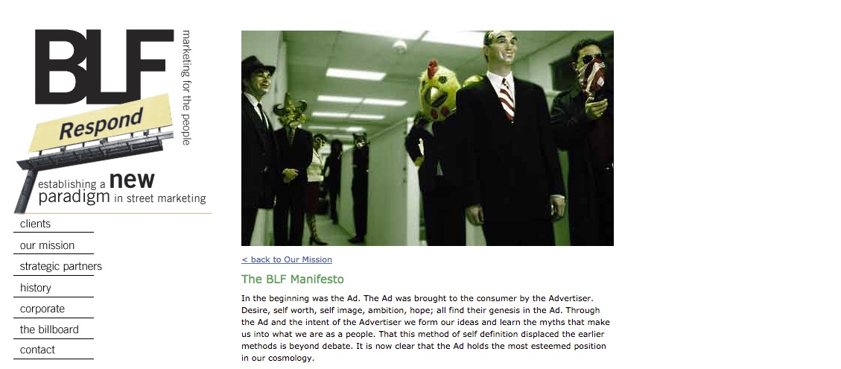
Billboard Liberation Front
Notes:
Style: minimalist,
Target: Billboard, Transit ads, Street furniture
Purpose: changing the viewers’s consciousness in a simple way.
Not damaging the ads.

Slide 9
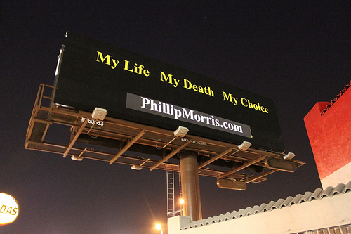

Slide 11
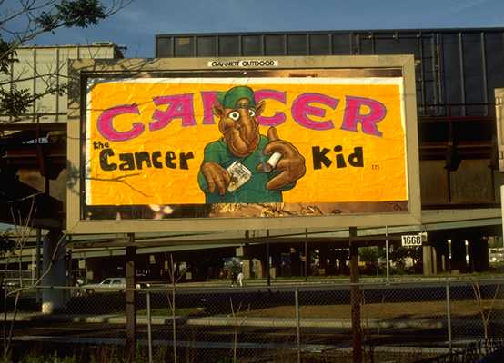

Slide 12
Alternate Message

Slide 13
Types of Cultural Jamming
Social: Of course, some culture jams are playful in nature and target society in general, being satirically oriented at anything from a holiday to a particular political leader or recognizable symbol.
Notes:
They may cause one to rethink reality, or simply laugh at something twisted to be slightly more-than-ordinary. The best subversive street art videos and images, of course, cause us to do both.

Slide 14
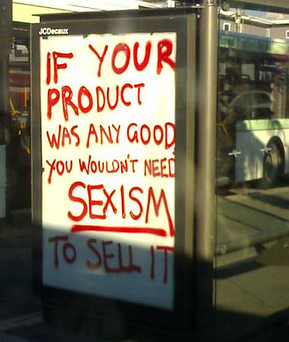

Slide 18
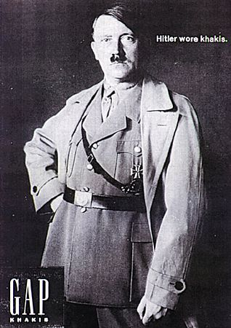

Slide 20
Types of Cultural Jamming
Political: Less common but equally powerful are political forms of culture jamming.
Notes:
The above examples play on everyday symbols people normally wouldn’t think twice about. By subtly changing their meaning, the ordinary becomes extraordinary, and takes on significance beyond what is expected. Respectively, the above signs deal with complex issues of political asylum in Australia and the contentious Iraq War.culture jamming is subvertising.

Slide 21
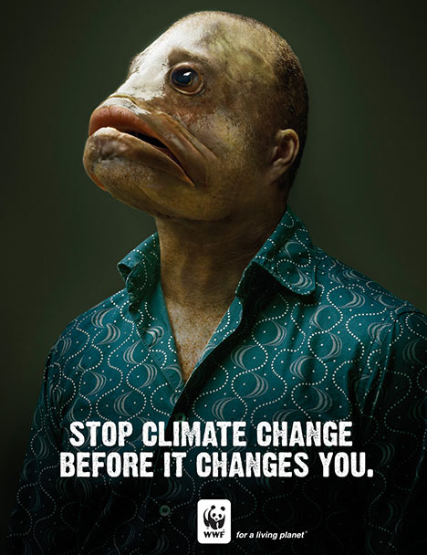

Slide 22
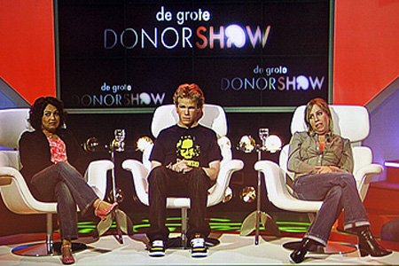

Slide 23
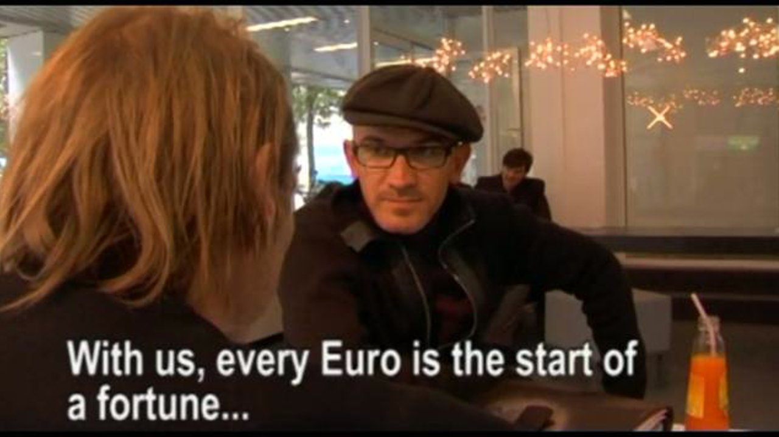
The ACE-bank Hoax (2006)
Netwerk Vlaanderen

Slide 24
Barbie Liberation Organization

Slide 25
Notes:
The Yes Men strike again. Impersonating a Dow Chemical spokesman on BBC, "Jude Finisterra" promises a huge compensation for the thousands of victims of the Bhopal disaster in which Dow Chemical's subsidiary Union Carbide India was responsible for in 1984.

Slide 26
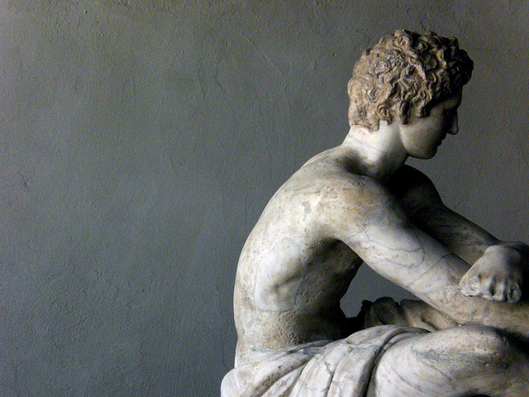
Majken Jul Sørensen
A humorous political stunt is a performance/action carried out in public which attempts to undermine a dominant discourse. It is either so confrontational that it cannot be ignored or involves a deception that blurs the line between performers and audiences. It includes or comments on a political incongruity in a way that is perceived as amusing by at least some people who did not initiate it.
Notes:
corpo di marmo by federico borghi cc by sa

Slide 27
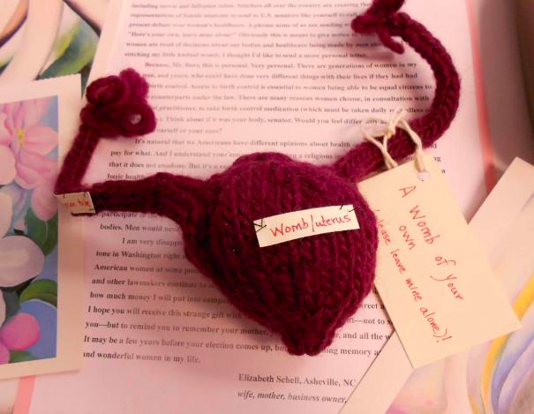
The Snatchel Project

Slide 28
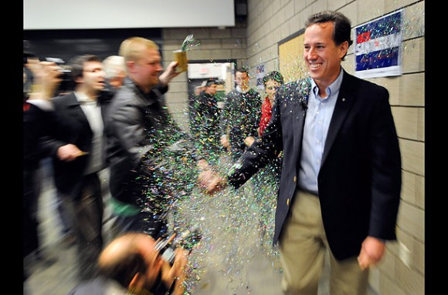
Glitter bombing

Slide 29
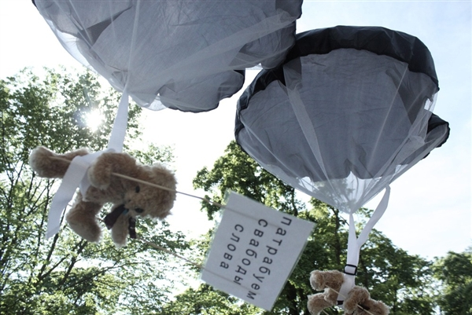
Teddy bears over Belarus

Slide 30
Political Activism

Slide 31
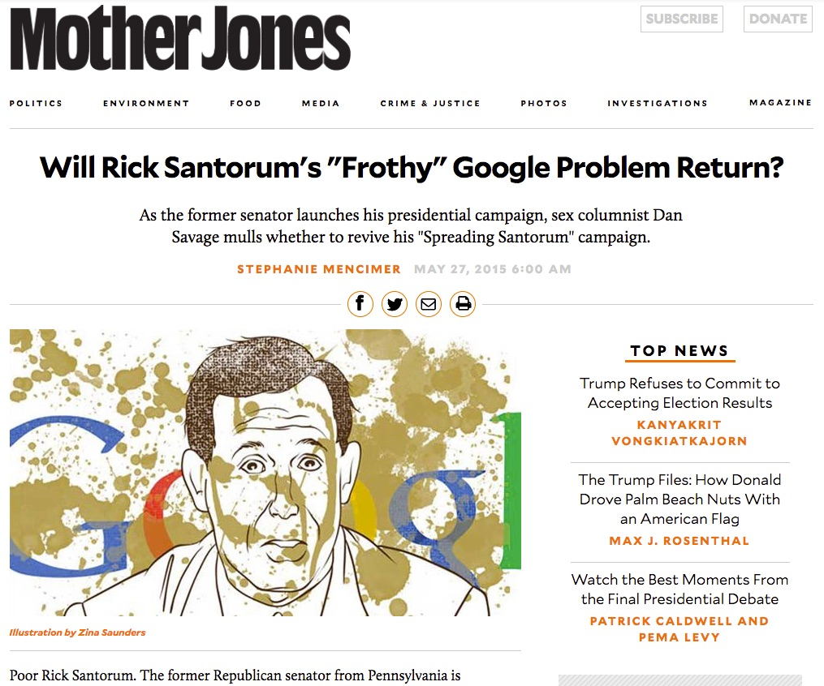
Notes:
http://www.motherjones.com/politics/2015/05/rick-santorum-2016-dan-savage-google

Slide 32
Redirecting Google searches

Slide 33
Who speaks in the public space?

Slide 34
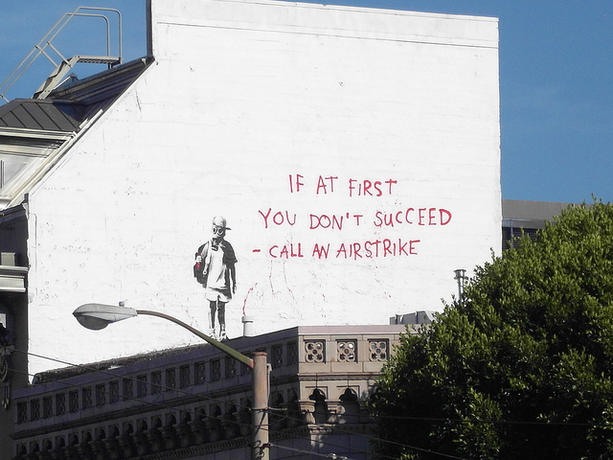
Notes:
Artistic Political Speech by Cory M. Grenier CC BY SA

Slide 35
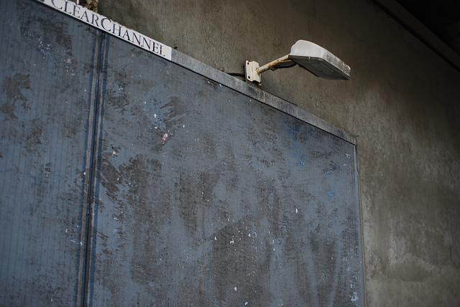
Clear Channel Outdoor Holdings
Worlds largest, operations in six of the seven continents
Notes:
Ad Space by Thomas Angermann CC BY NC SA

Slide 36
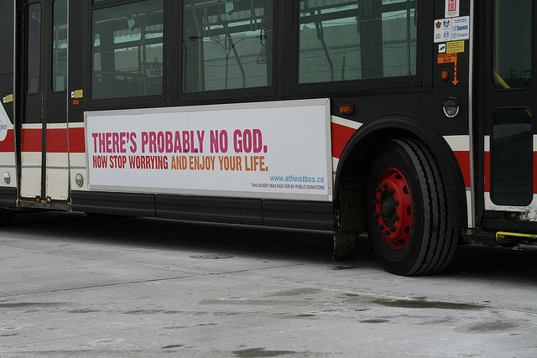
Notes:
Atheist Bus - Toronto by Atheist Bus Canada cc by

Slide 38
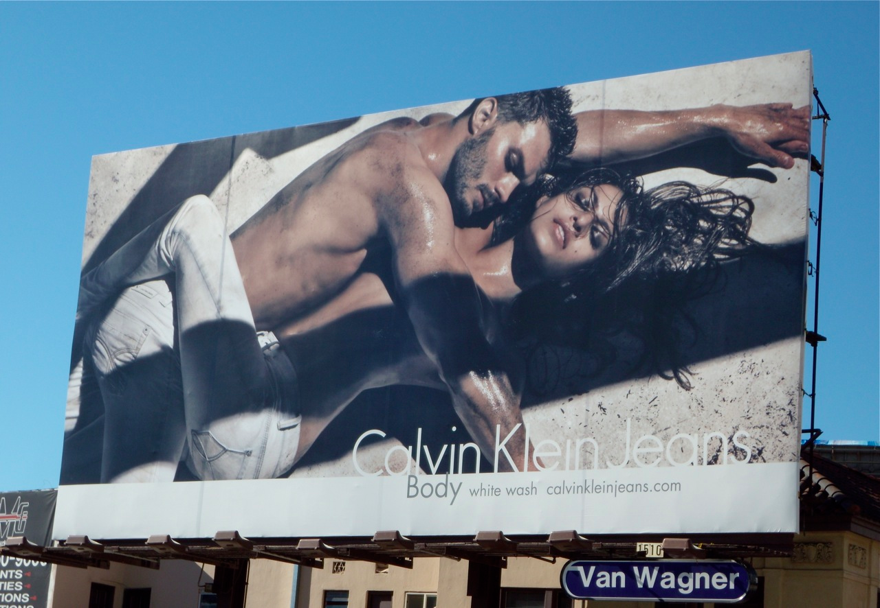

Slide 39
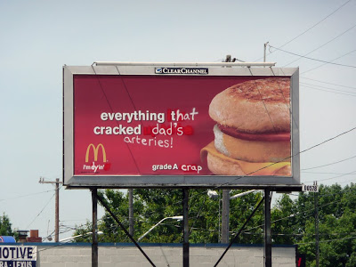

Slide 40
Short Version of Sao Paolo Clean City Law
https://www.youtube.com/watch?v=G08h6HLBRD8
Notes:
Short Version of Sao Paolo Clean City Law
https://www.youtube.com/watch?v=G08h6HLBRD8

Slide 41
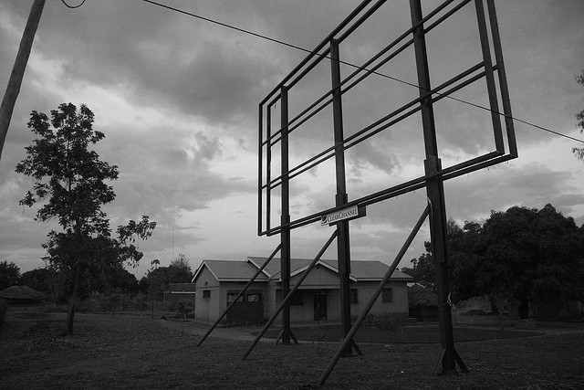
Baltimore Billboard Tax (2013)
Notes:
Arguing that billboards should be protected as free speech by the First Amendment, media firm Clear Channel Outdoor has filed a federal lawsuit against Baltimore and its new billboard tax. Baltimore began imposing a tax last month on billboard advertisements within the city limits — $15 per square foot for billboards that electronically change images, and $5 per square foot for those that don't.
Otino Waa0206_filtered by Jonathan Assink CC BY ND

Slide 42
Surveillance
Notes:
Geneva - Jardin anglais - Binoculars by dibaer cc by sa

Slide 43
https://www.youtube.com/watch?v=RILTl8mxEnE
Notes:
The Surveillance Camera Players (SCP), based in New York City and founded by Bill Brown, are one of the main innovators of this art form. This group of actors stages various plays in public spaces, their first one being Alfred Jarry’s "Ubu Roi" on December 10, 1996 at the 14th Street-Union Square Subway station. They have performed other famous works such as Samuel Beckett’s Waiting for Godot, Edgar Allan Poe’s The Raven, George Orwell’s 1984 and Animal Farm. Their plays are staged in very public places such as subway stations, Times Square, Rockefeller Center, Washington Square Park, Union Square, and various other landmarks throughout the city. http://en.wikipedia.org/wiki/Surveillance_art

Slide 44
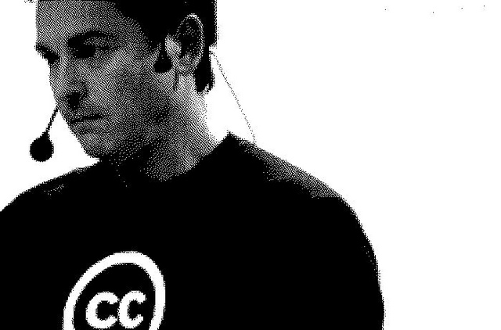
Mathias Klang
www.klangable.com
Image & licensing info in the notes section of slides.
Images at www.flickr.com (or specifically stated).
This ppt licensed: Creative Commons BY-NC-SA
Download presentation
www.slideshare.net/klang

