Slide 1
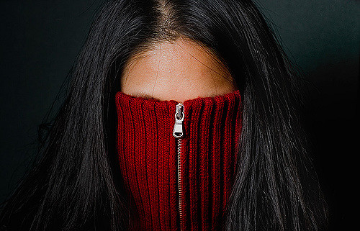
Clothing & Privacy
Mathias Klang @klangable klang@umb.edu

Slide 2
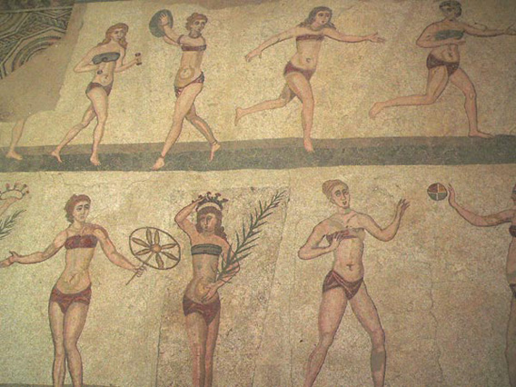
Notes:
The ancient Roman Villa Romana del Casale (286–305 AD) in Sicily contains one of the earliest known illustrations of a bikini.

Slide 3
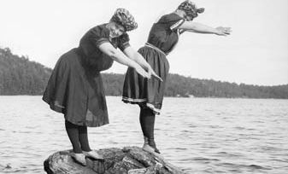
Notes:
Loose chemises from 1900s

Slide 4
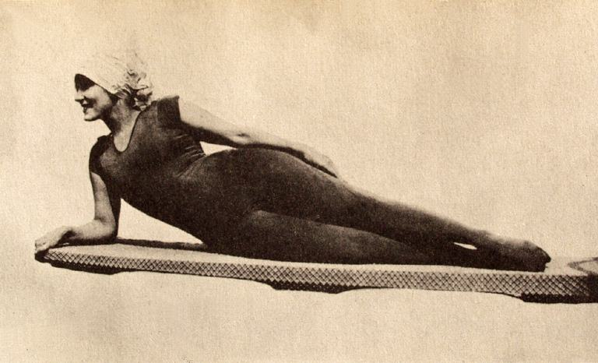
Annette Kellerman started the form-fitting swimwear trend, 1909
Notes:
Annette Kellerman started the form-fitting swimwear trend, 1909

Slide 5
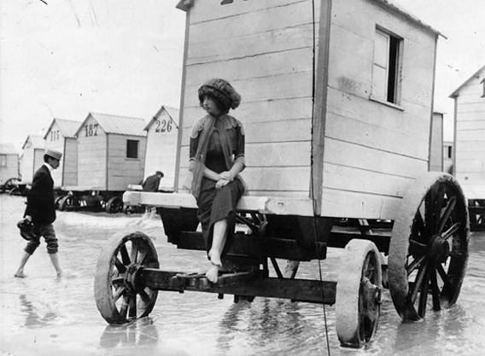
Notes:
Woman perching on the edge of a bathing machine at an Ostend, Belgium, beach.

Slide 6
Men’s “Free the Nipple” in the 1930s

Slide 7
It Happened One Night (1934)
Notes:
Clark Gable & Claudine Colbert

Slide 8
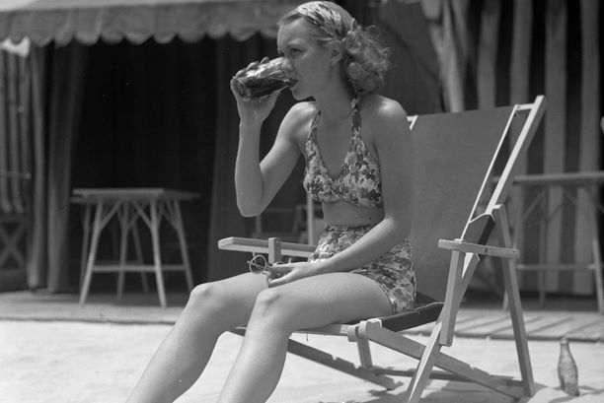
Jane Wyman, 1935
Notes:
Actress Jane Wyman in beachwear that bares legs and midriff, 1935

Slide 9
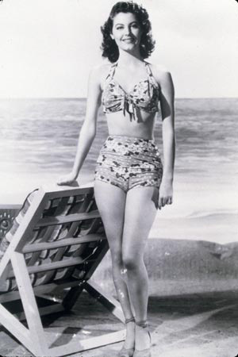
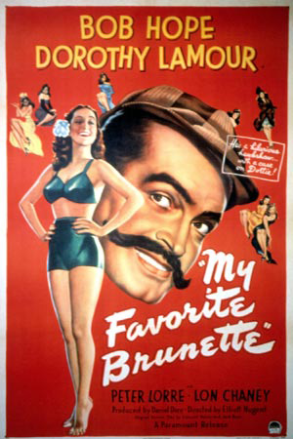
Notes:
Ava Gardner, Hollywood, Calif., 1941.
Poster of My Favorite Brunette, 1947.

Slide 10
Micheline Bernardini modeling Louis Réard's bikini. It was small enough to fit into a 2 by 2 inches (51 by 51 mm) box like the one she is holding. July 5, 1946.
Notes:
Micheline Bernardini modeling Louis Réard's bikini. It was small enough to fit into a 2 by 2 inches (51 by 51 mm) box like the one she is holding. July 5, 1946.

Slide 11
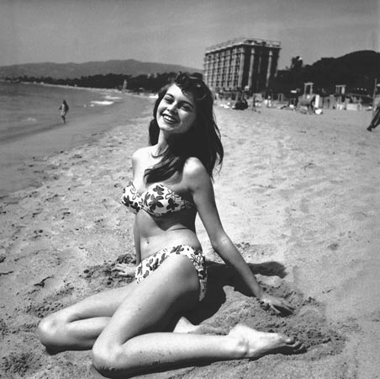
Brigitte Bardot, 1953
Notes:
Brigitte Bardot at the 6th International Cannes Film Festival, 1953.

Slide 12
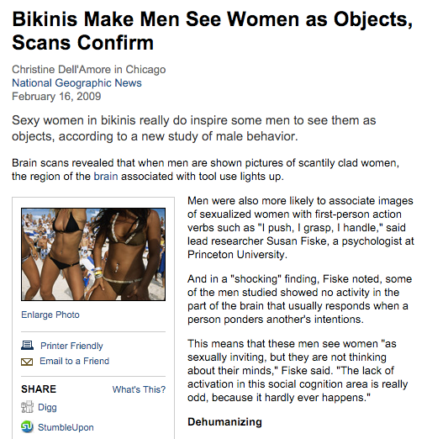

Slide 13
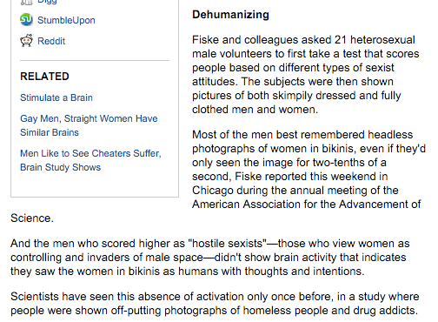

Slide 15
Qatari women basketball team forfeit match for wearing hijab (2014)
Virginia teen asked to leave because of short dress. Dads had her removed in case she gave boys “impure thoughts” (2014)
UK Schoolgirls Sent Home Because Their Trousers Were “Too Tight” (2014)
Michigan leggings are “too distracting” & encouraging girls to go out with “little to no clothing on” (2014)
13 year olds in Illinois told that leggings “too distracting to boys” (2013)

Slide 16
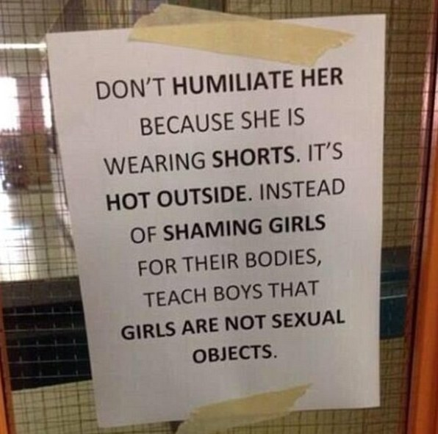
11th grader in Montreal told, in front of her class, shorts were too short and that she would have to change or face suspension

Slide 17
Laci Green Dress Code Sexism
https://www.youtube.com/watch?v=41J4XBjgOrw
Notes:
https://www.youtube.com/watch?v=41J4XBjgOrw

Slide 18
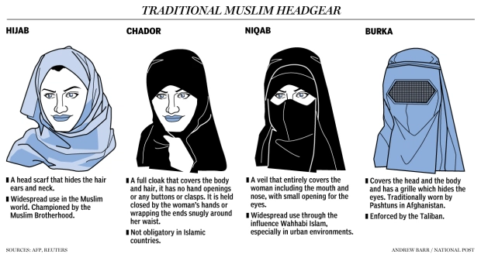
Religious Dress

Slide 19
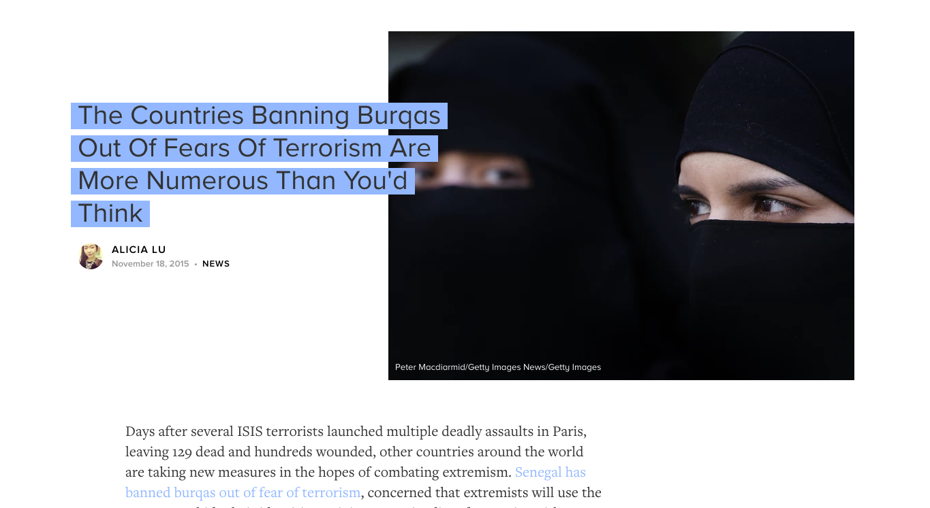

Slide 20
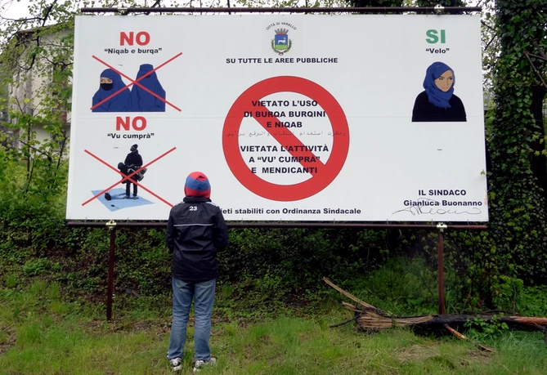

Slide 21
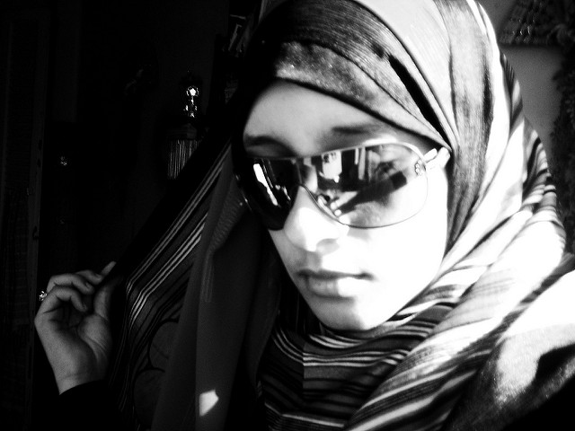
Incomplete list
Syria (2010)
Italy (any garments that mask identification since the 1970s & local)
Russia (2013)
The Netherlands (on public transportation or in schools)
Spain (local bans, but 2013 the Spanish Supreme Court overturned the ban, calling it "unconstitutional.")
Belgium
France
Cameroon
Chad
Notes:
fixing my hijab by rana ossama cc by sa
http://www.bustle.com/articles/124682-the-countries-banning-burqas-out-of-fears-of-terrorism-are-more-numerous-than-youd-think

Slide 22
Amnesty International statement on right to wear religious garb

Slide 24
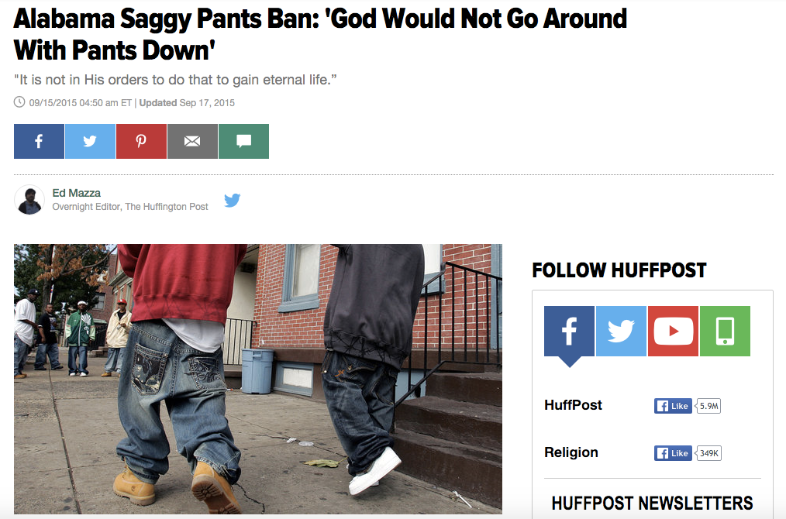
Russia Banned emo clothing

Slide 25
FBI & Insane Clown Posse
Notes:
The FBI's classification of Juggalos as a gang has caused confusion, resulting in many peaceful, non-criminal Juggalos being discriminated against both by police and by ordinary citizens

Slide 26
Notes:
http://thefreethoughtproject.com/judge-bans-words-black-lives-matter-clothing-courtroom-activists-claim-free-speech-violation/

Slide 27
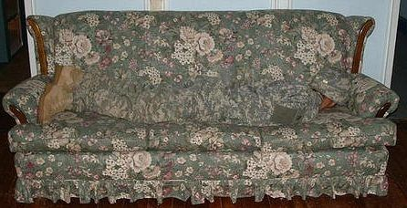
Hiding in plain sight
Eight years after spending $5 billion on a heavily-criticized universal camouflage pattern, the Army is back at the drawing board looking for a new design that’s estimated to cost another $4 billion.

Slide 28
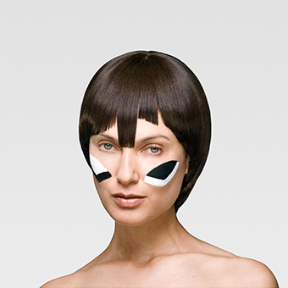
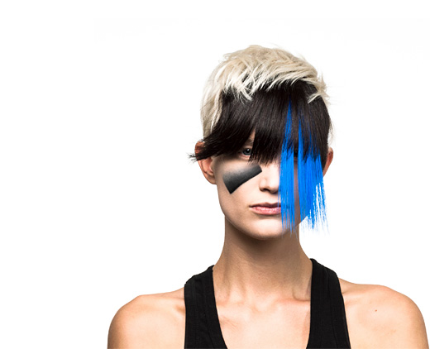
CV Dazzle explores how fashion can be used as camouflage from face-detection technology, the first step in automated face recognition.
Notes:
https://cvdazzle.com/

Slide 29
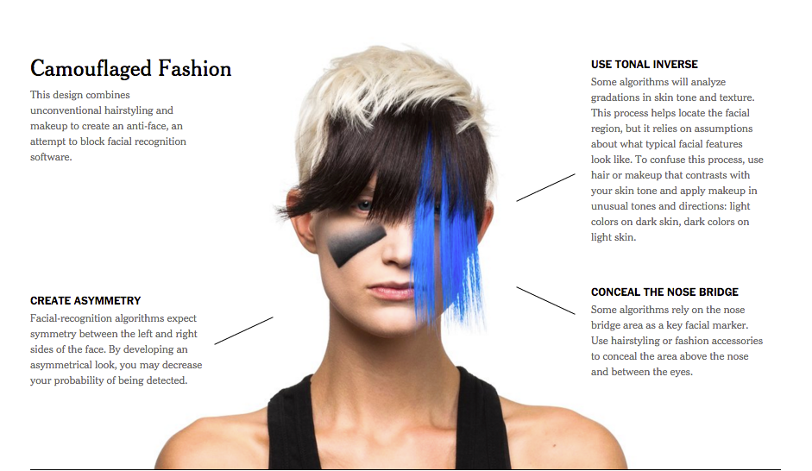

Slide 30
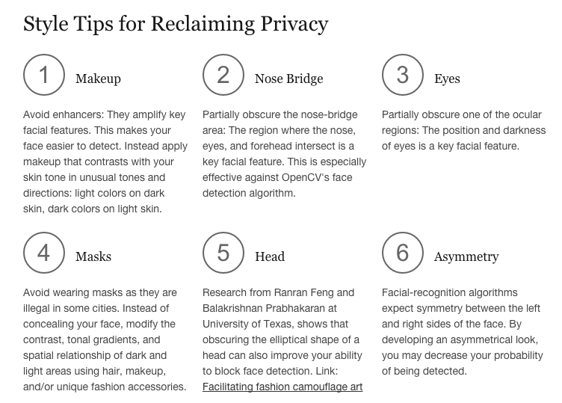

Slide 31
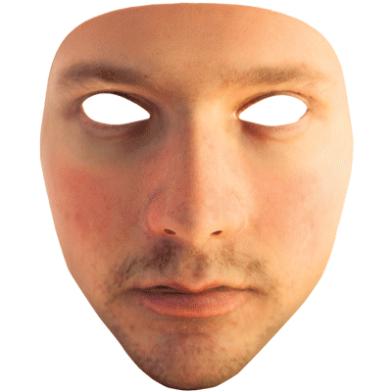
Leo Selvaggio and founder of URME Surveillance
Notes:
Leo Selvaggio and founder of URME Surveillance

Slide 32
Banning masked protest

Slide 33
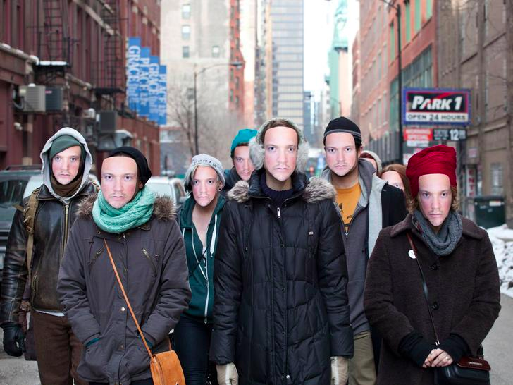

Slide 34
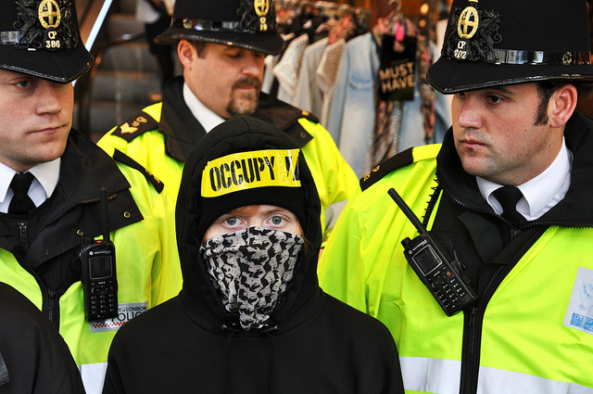
Notes:
M15 - Occupy London - May 2012 Street Protest - 15.5.12 Darren Johnson iDJ Photography cc by nc nd

Slide 35
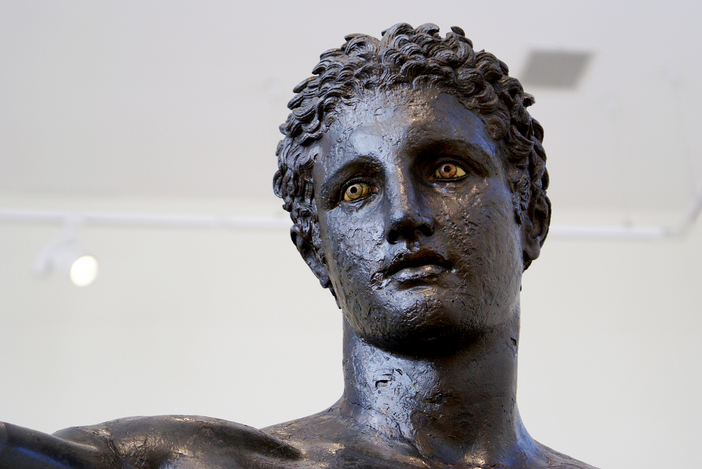
Thank you!
Notes:
Eyes ! (Youth from Antikythera!) by agelakis cc by nc sa

Slide 36
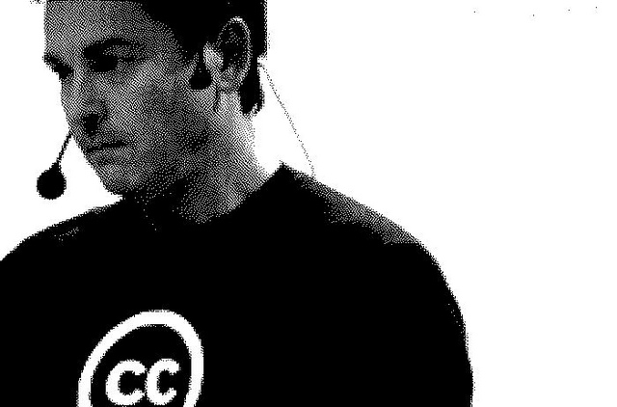
Mathias Klang
@klangable
www.klangable.com
Image & licensing info in the notes section of slides.
Images at www.flickr.com (or specifically stated).
This ppt licensed: Creative Commons BY-NC-SA
Download presentation
www.slideshare.net/klang

