Slide 1
Cyberutopians & cyberpessimists
Mathias Klang
@klangable
klang@umb.edu

Slide 2
The future is already here — it's just not very evenly distributed.
-William Gibson, 1993

Slide 3
A democratic constitution, not supported by democratic institutions in detail, but confined to the central government, not only is not political freedom, but often creates a spirit precisely the reverse.
- Mill, 1848

Slide 4
UK Parliament

Slide 5
Here is a very potent factor in our political life. The semicircular assembly, which appeals to political theorists, enables every individual or every group to move round the centre, adopting various shades of pink according as the weather changes…The party system is much favoured by the oblong form of chamber. It is easy for an individual to move through those insensible gradations from Left to Right, but the act of crossing the Floor is one which requires serious attention.
- Churchill, 1951

Slide 6
Cyberspace. A consensual hallucination experienced daily by billions of legitimate operators, in every nation, by children being taught mathematical concepts... A graphic representation of data abstracted from banks of every computer in the human system. Unthinkable complexity. Lines of light ranged in the nonspace of the mind, clusters and constellations of data. Like city lights, receding...”
-William Gibson, Neuromancer, 1984

Slide 7
What is Moore's Law, and why it Matters

Slide 8
Moore’s Law

Slide 9
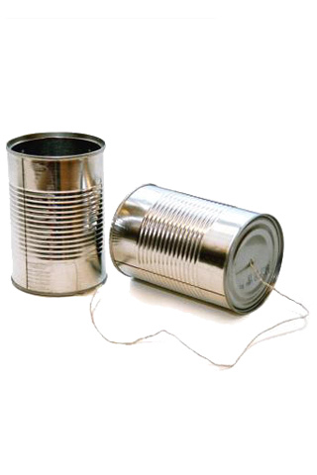
Your smartphone is more powerful than computer calculating the moon landing
Notes:
tin can phone from K!T cc by nc nd

Slide 10
Quantity has a quality all of its own

Slide 11
Virtual Communities

Slide 12
We reject kings, presidents and voting. We believe in rough consensus and running code
IETF Credo. David Clark (1992)

Slide 13
The Net interprets censorship as damage and routes around it.
John Gilmore, 1993, 1994

Slide 14
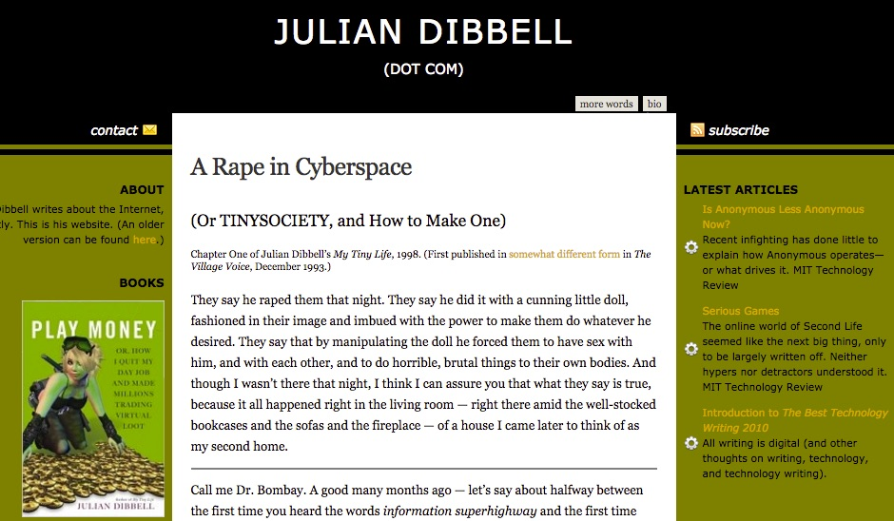
LambdaMoo...
-A Rape in Cyberspace, 1993

Slide 15
National borders aren't even speed bumps on the information superhighway.
Tim May,1996

Slide 16
Governments of the Industrial World, you weary giants of flesh and steel, I come from Cyberspace, the new home of Mind. On behalf of the future, I ask you of the past to leave us alone. You are not welcome among us. You have no sovereignty where we gather...We are forming our own Social Contract. This governance will arise according to the conditions of our world, not yours. Our world is different.
-A Declaration of the Independence of Cyberspace
John Perry Barlow, 1996

Slide 17
Rules evolve spontaneously in the marketplace and are mostly accepted by common consent. Common-law courts just keep things tidy at the edges… The good rules gain acceptance by the community at large, as people conform their conduct to rulings that make practical sense
Law and Disorder in Cyberspace
Huber, 1997

Slide 18
Code is Law
Actually it always was
“Architecture is politics”
Mitch Kapor, 1991

Slide 19
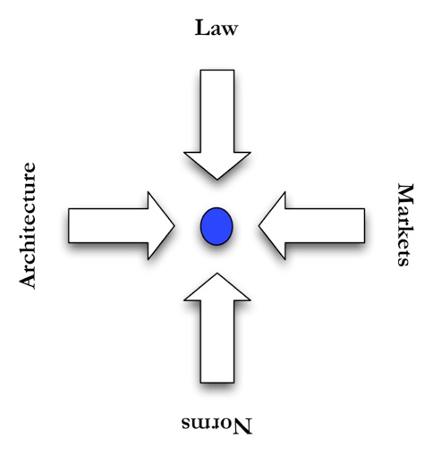
Lessig, 1991

Slide 20
Notes:
Drive Slow by Shawn Semmes cc by nc

Slide 21
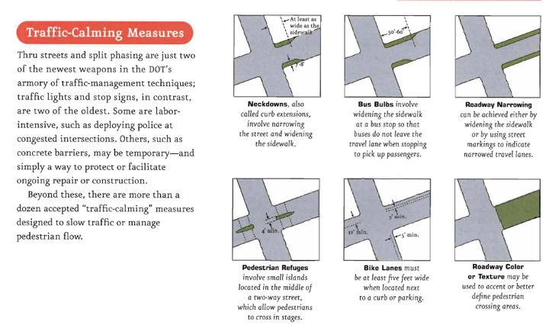

Slide 22
Polycentric Regulatory processes

Slide 23
Like all technology, social media is neutral but is best put to work in the service of building a better world.
Simon Mainwaring

Slide 24
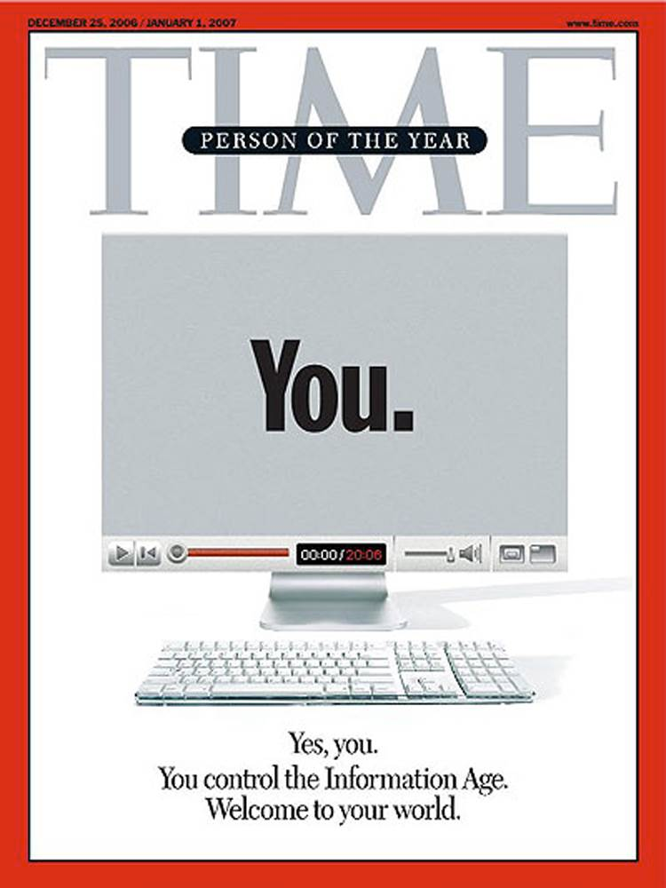

Slide 25
Social media is the ultimate equalizer. It gives a voice and a platform to anyone willing to engage.
Amy Jo Martin

Slide 26
RSA Animate - The Internet in Society: Empowering or Censoring Citizens
Morosov, The Net Delusion, 2012

Slide 27
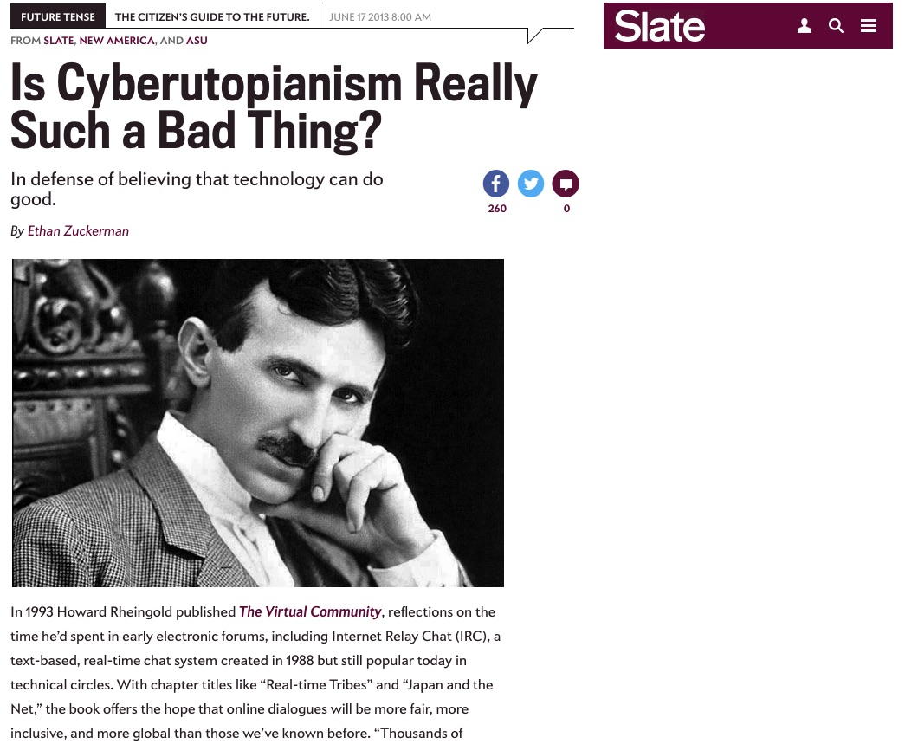
Notes:
Is Cyberutopianism Really Such a Bad Thing?
http://www.slate.com/articles/technology/future_tense/2013/06/cyberutopianism_should_not_be_a_dirty_word.html

Slide 28
The term 'cyberutopian' tends to be used only in the context of critique. Calling someone a cyberutopian implies that he or she has an unrealistic and naively overinflated sense of what technology makes possible and an insufficient understanding of the forces that govern societies.
-Ethan Zuckerman, 2013

