Slide 1
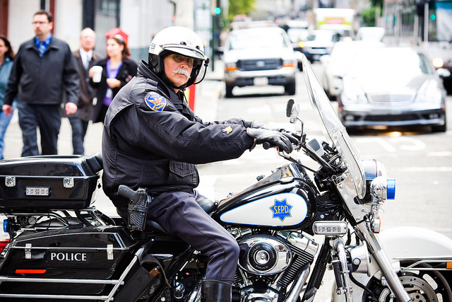
The Gaze and The Panopticon
Mathias Klang
@klangable
klang@umb.edu
Notes:
Police by Thomas Hawk CC BY NC

Slide 2
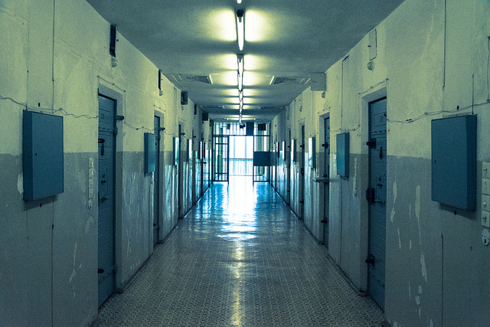
What is the purpose of prison?
Notes:
Prison Stasigefängnis Berlin by StefanieKaufmann CC BY NC ND

Slide 3
Penal transportation
Penal transportation of convicted criminals to penal colonies in the British Empire—in the Americas between the 1610s and 1770s and in Australia between 1788 and 1868—was often offered as an alternative to the death penalty, which could be imposed for many offenses.

Slide 4
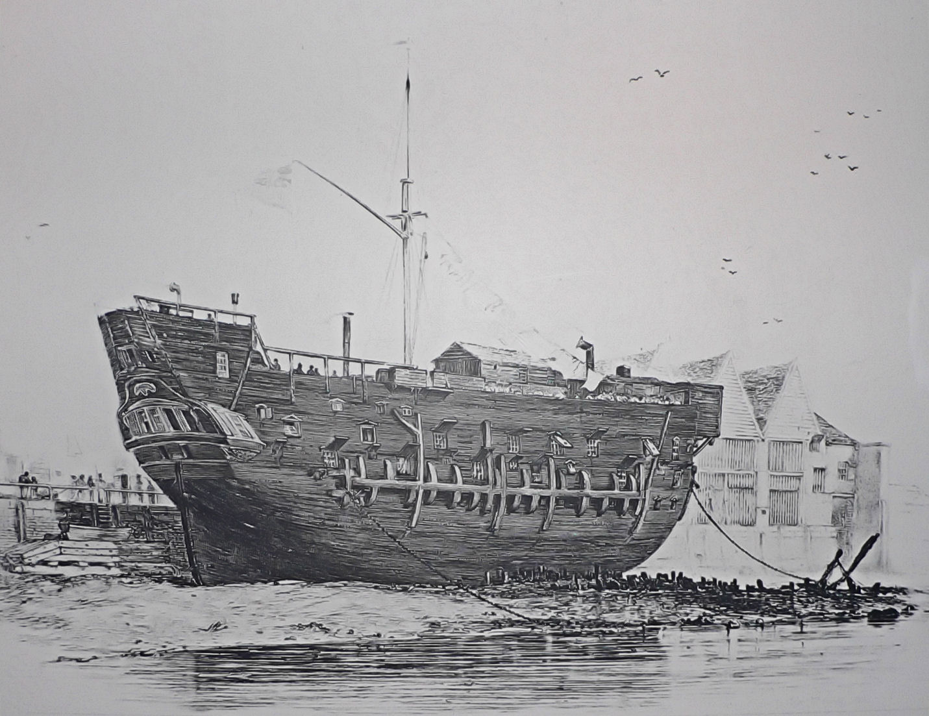
Notes:
The beached convict ship HMS Discovery at Deptford served as a convict hulk between 1818 and 1834.

Slide 5
Bentham and the penitentiary Projects

Slide 6
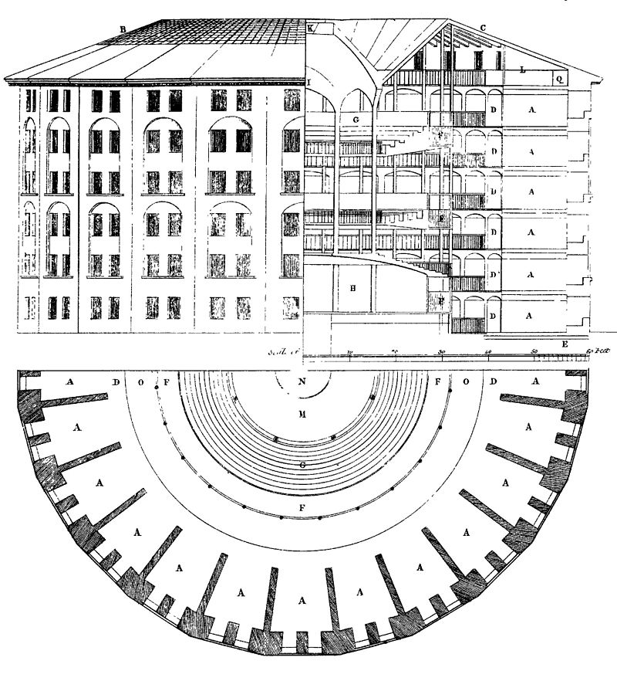

Slide 7
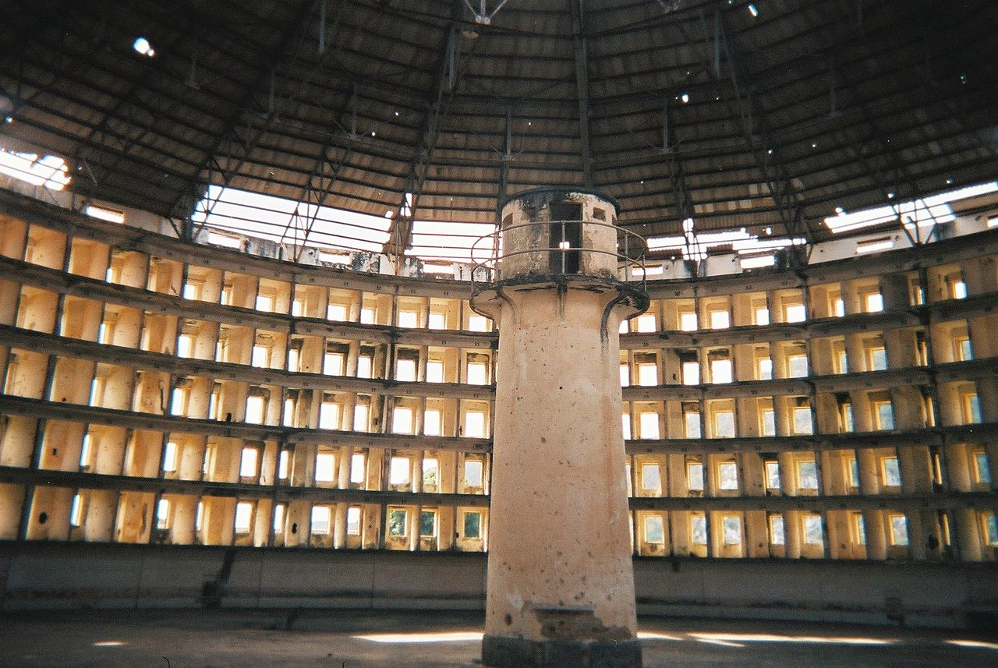
Notes:
Presidio Modelo prison, inside one of the buildings, 2005

Slide 8
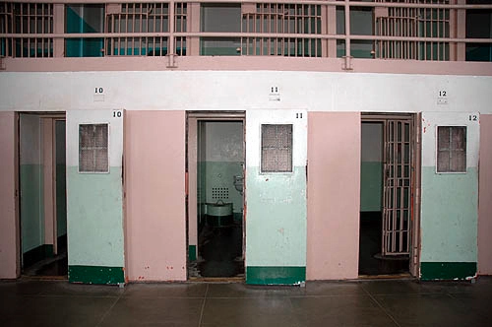
Notes:
Solitary Confinement in Alcatraz

Slide 9
Notes:
Eastern State Penitentiary, now a museum

Slide 10
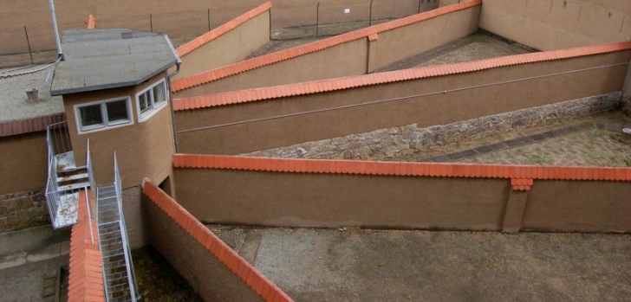
Notes:
Walled prison yards for prisoners in solitary

Slide 11
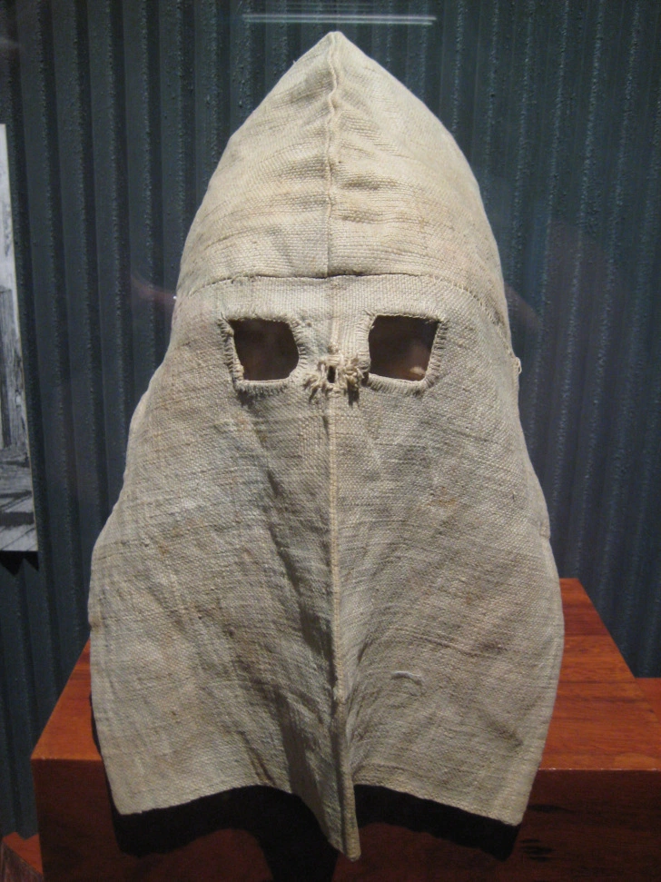
Notes:
A hood worn by prisoners in solitary confinement outside their cells, c. 1875. Via Wikimedia Commons.

Slide 13
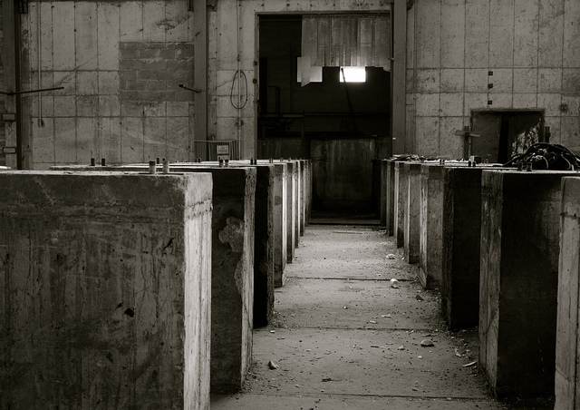
Schools, factories and armies
Notes:
Factory by astrid westvang CC BY NC ND

Slide 14
The Gaze
Lacan argues that the subject loses a degree of autonomy upon realizing that he or she is a visible object
Notes:
Gaze as relationship

Slide 15
Social ties and relations
The gaze is not something one has or uses; rather, it is the relationship into which someone enters.

Slide 16
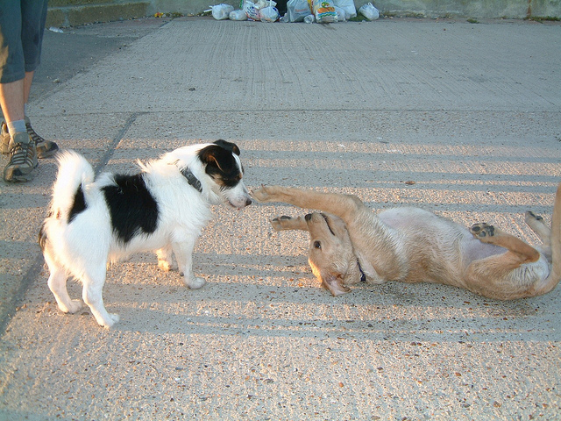
The authoritarian gaze
Notes:
I surrender by Les Chatfield CC BY

Slide 17
“Men Act And Women Appear. Men look at women. Women watch themselves being looked at”
John Berger

Slide 18
“The naked body has to be seen as an object in order to be a nude.” John Berger

Slide 19
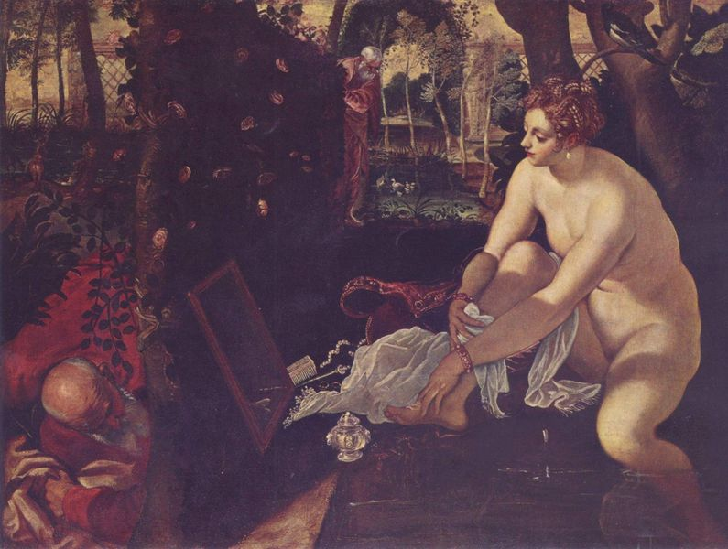
Susannah and the Elders by Tintoretto (1518 – 1594)
Notes:
Susannah is “naked as the spectator sees her...She looks back at us looking at her” in another painting; in this one, she “is looking at herself in the mirror. Thus she joins the spectators of herself” (50)

Slide 20
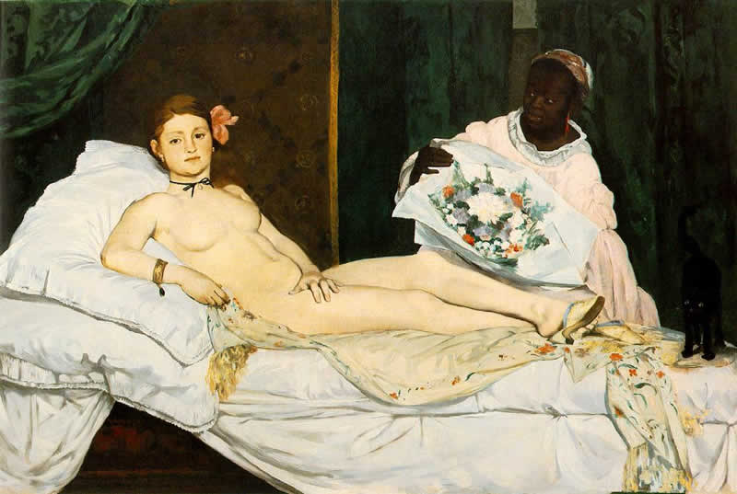
Olympia by Manet (1832 – 1883)
Notes:
“The ideal was broken” (63)

Slide 21
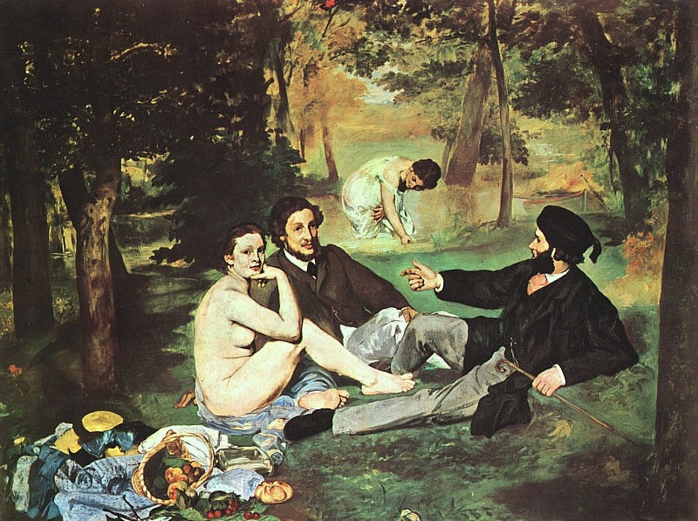
The Male Gaze

Slide 22
The Male Gaze: How Women Are Presented In Beer Ads by zach mueller
https://www.youtube.com/watch?v=1zZxWQ97RFA

Slide 25
What’s wrong with these images?

Slide 28
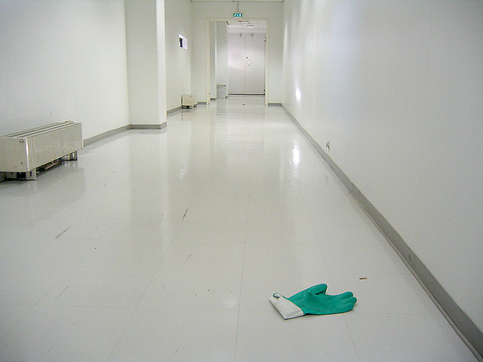
Privacy is Power
Privacy is the power to selectively reveal oneself to the world.
Notes:
Lost & Found (Book of Glove) By Wojtek Mejor cc by sa

Slide 29
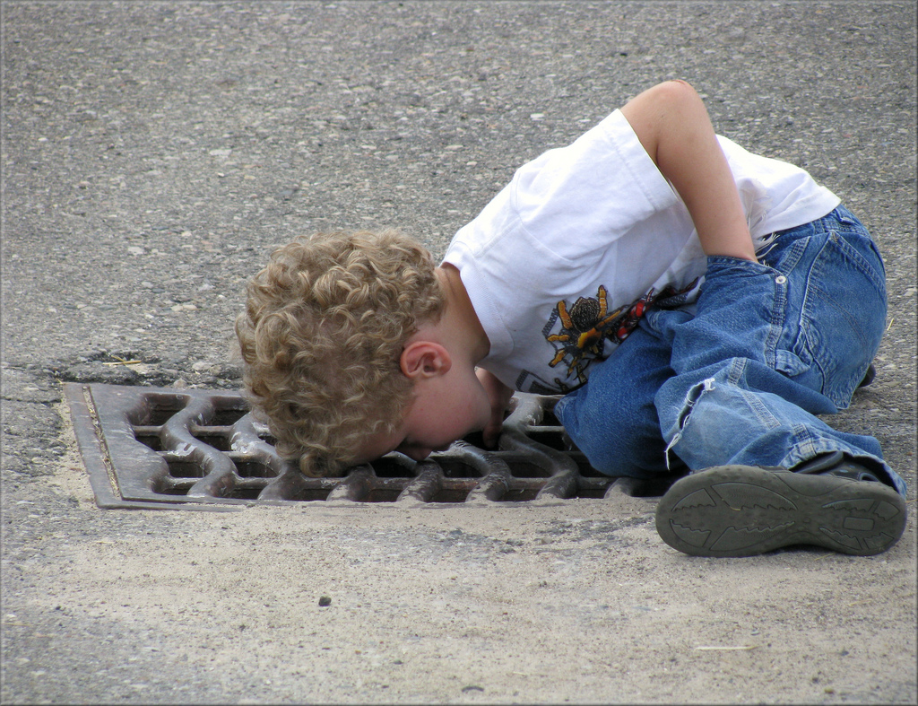
If privacy is power, then surveillance is…
Notes:
Looking for gators..... from katieb50 cc by

Slide 30
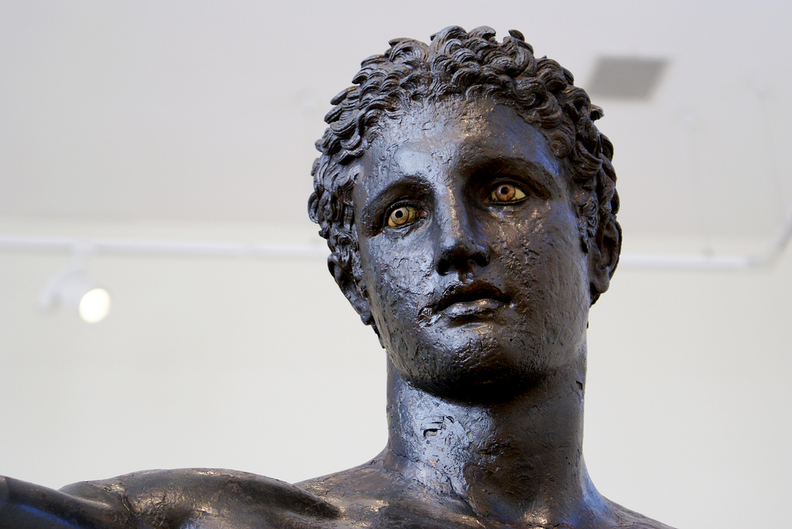
Thank you!
Notes:
Eyes ! (Youth from Antikythera!) by agelakis cc by nc sa

Slide 31
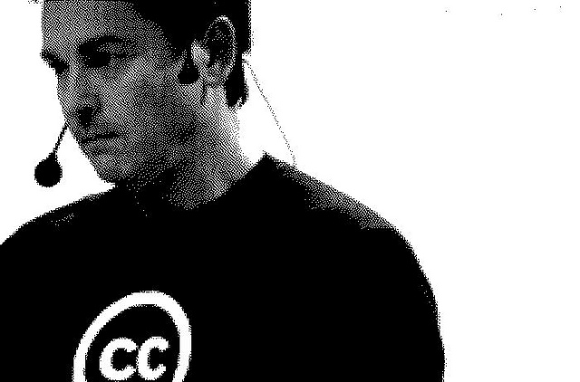
Mathias Klang
@klangable
www.klangable.com
Image & licensing info in the notes section of slides.
Images at www.flickr.com (or specifically stated).
This ppt licensed: Creative Commons BY-NC-SA
Download presentation
www.slideshare.net/klang

