Slide 1
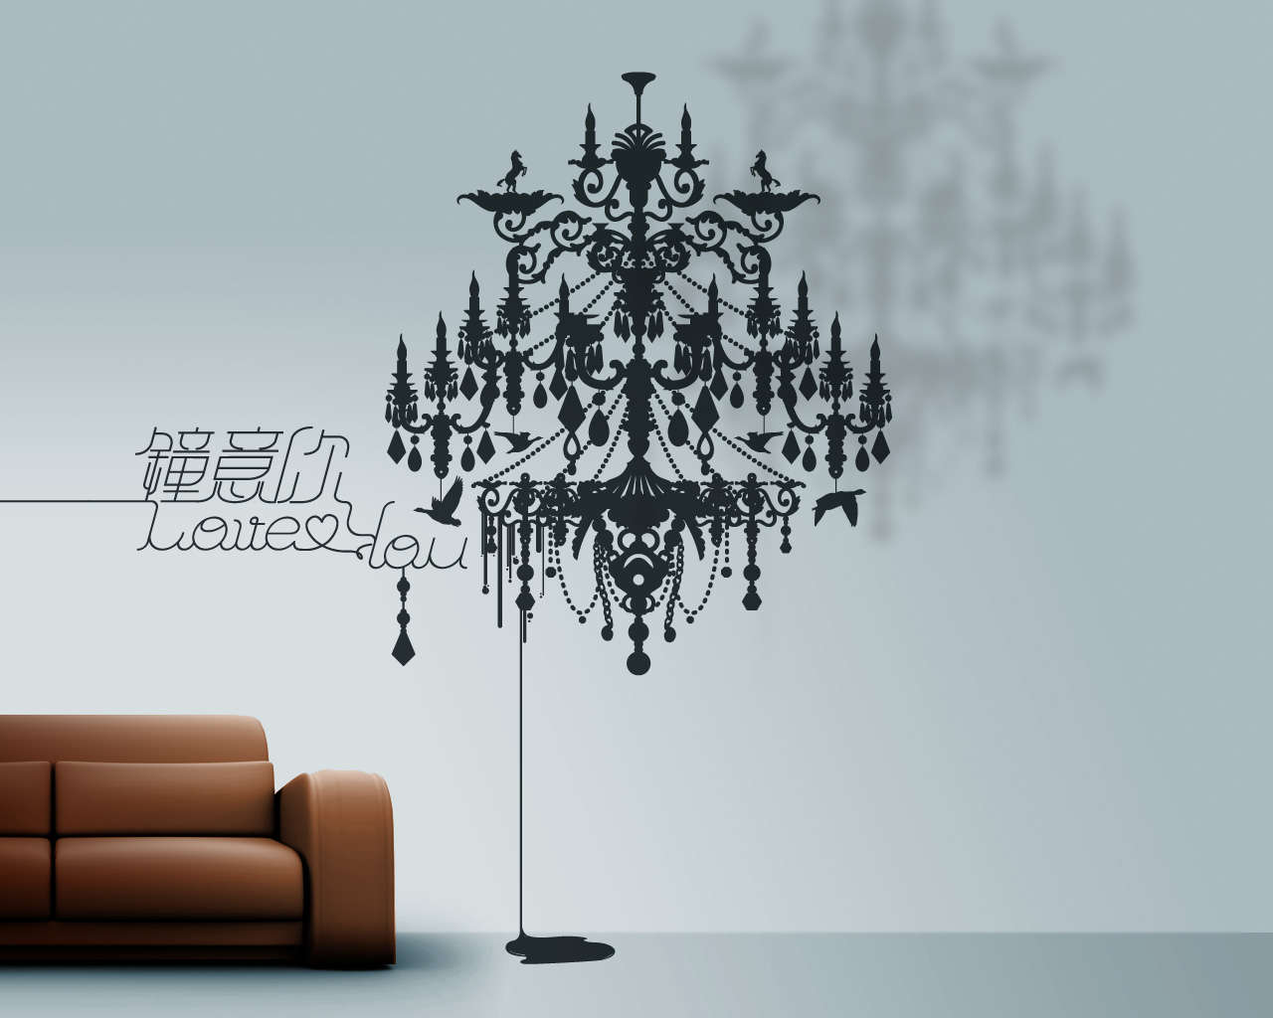
The Home & Privacy
Mathias Klang
@klangable klang@umb.edu
Notes:
Wallpaper from Nod Young cc by nc sa

Slide 2
“A mans home is his castle”
William Pitt (1776) “The poorest man may in his cottage bid defiance to all the forces of the Crown. It may be frail—its roof may shake—the wind may blow through it—the storm may enter—the rain may enter—but the King of England cannot enter!” Indeed, the law even recognizes a certain zone of privacy around the home that we can reasonably expect to reserve for ourselves. That space, along with our house, is protected by the Fourth Amendment. Under the law, this area is known as the “curtilage.” To most of us, it is known as our yard.

Slide 3
Examples?
Privacy in the home is something to be negotiated within the constraints of the physical dwelling which defines the space available, and the social roles which shape opportunities quite differently for women, men and children. Both the physical space and the social roles can be highly restrictive. It is this which constitutes the home as an important locale’ (Giddens, 1984) in which ideologies of family and gender are reflected, rejected or confirmed
Moira Munro & Ruth Madigan (1993) Privacy in the private sphere, Housing Studies, 8:1, 29-45
Notes:
Moira Munro & Ruth Madigan (1993) Privacy in the private sphere, Housing Studies, 8:1, 29-45

Slide 4
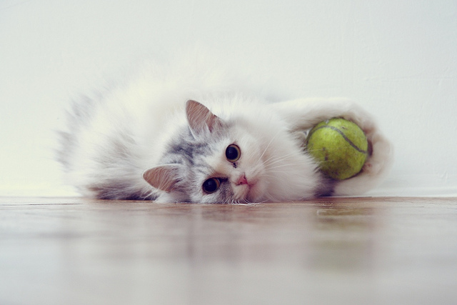
Some words on design
Notes:
j by Marina Perevezentseva cc by nc nd

Slide 5
Technologies of privacy
Simple houses have low priority attached to individual privacy, as dwellings often consisted of a single communal room and were almost always crowded. However, the turn of the century saw the beginning of what architectural historians consider a revolution in English housing. Partitioned living and sleeping areas gradually became the norm, followed by the use of second stories to add even more rooms. While partitioned rooms first appeared in upper class homes, they quickly found favor with the lower classes as well

Slide 6
Technologies of privacy
In addition to sanitary facilities, the development of the washing machine further reduced the need to leave the house. The refrigerator, moreover, reduced the frequency of shopping trips, thus compensating somewhat for the demise of the door-to-door peddlers who had previously brought many necessary goods to the home. Leisure activities also were increasingly drawn into the home with the development of mass-produced phonographs, radios, and eventually televisions. In a rapidly changing world, the opportunity to move leisure activities into the relative cultural and moral safety of the home was welcomed by many, particularly middle-class Americans

Slide 7
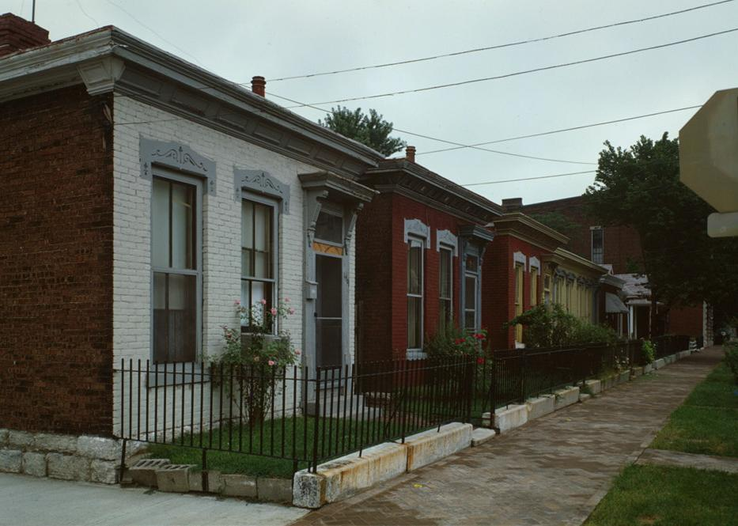
Shotgun House

Slide 8
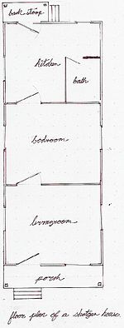
A "shotgun house" is a narrow rectangular domestic residence, usually no more than about 12 feet (3.5 m) wide, with rooms arranged one behind the other and doors at each end of the house. It was the most popular style of house in the Southern United States from the end of the American Civil War (1861–65), through the 1920s.

Slide 9
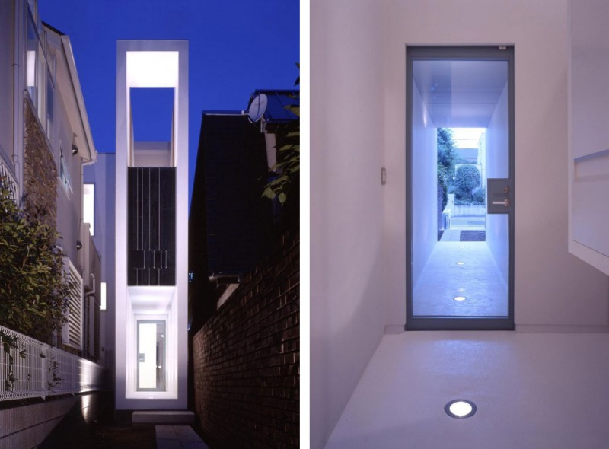
Flag Pole House
Notes:
http://www.busyboo.com/2014/07/16/narrow-site-house-flagpole/

Slide 10
John Archer (2005) Architecture and Suburbia: From English Villa to American Dream House, 1690-2000

Slide 11
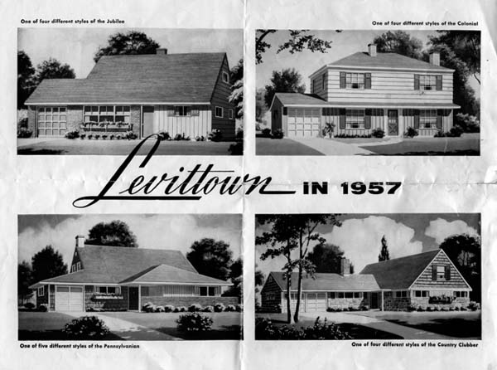
Sociotechnical American Dream
The 1950s issues mirrored important developments in the broader social climate. In 1949, the planned community of Levittown was built on Long Island. Levittown was a sea of identical, tiny Cape Cod houses, each a self-contained world made for a breadwinner and his wife and children. They were populated by returning veterans and stay-at-home wives. Each had a white picket fence, lawn, washing machine, and built-in TV. This isolated new suburb had no services and no public transportation. Nonetheless, the Levittown house became a ‘‘symbol of the dream of upward mobility and homeownership’’ (Lang 2007)

Slide 12
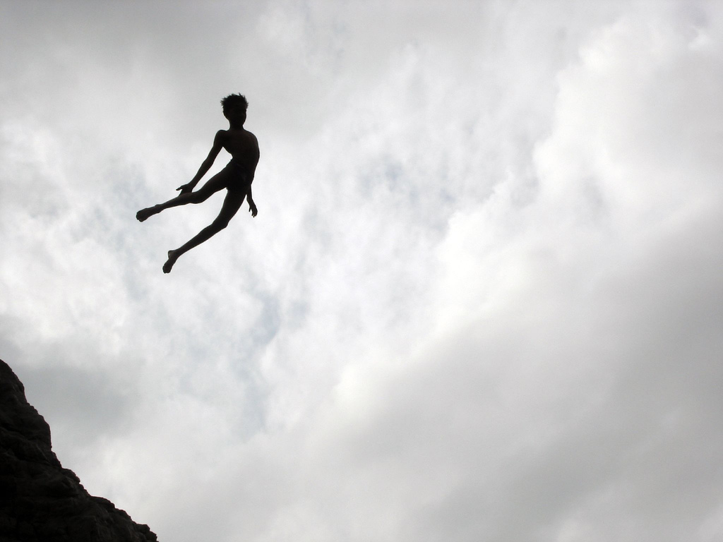
Westin (1970)
Even in societies in which people freely pass in and out of each other’s dwellings, conventions exist that circumscribe the behavior of both visitors and residents
Notes:
Knock or not, lock or not
What the boy did.. by shankar, shiv cc by nc sa

Slide 13
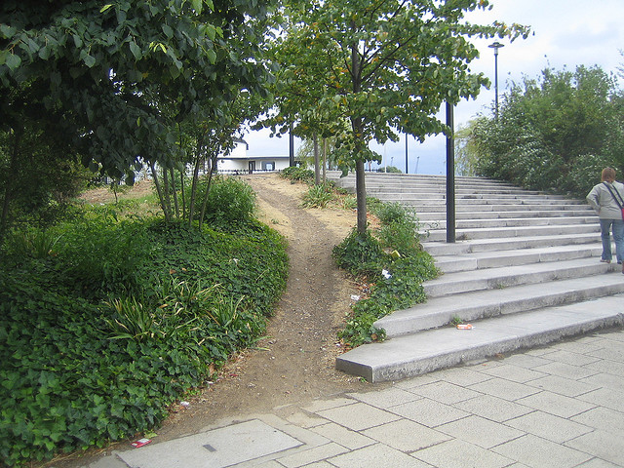
Desire paths and Regulation
When is it ok to cross neighbors yard?
Notes:
Desire Path (by the steps) By LoopZilla by sa

Slide 14
Jackson, 1997
‘‘By common consent, the appearance of a front yard, its neatness and luxuriance, is an index of the taste and enterprise of the family...Weeds and dead limbs are a disgrace, and the man who rakes and waters and clips after work is usually held to be a good citizen’’.
Notes:
Jackson , J. B. (1997b). Ghosts at the door. In H. L. Horowitz (Ed.), Landscape in sight: Looking at
America (pp. 106–117). New Haven: Yale University Press.

Slide 15
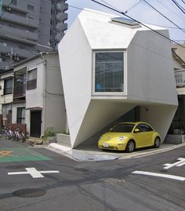

Slide 16
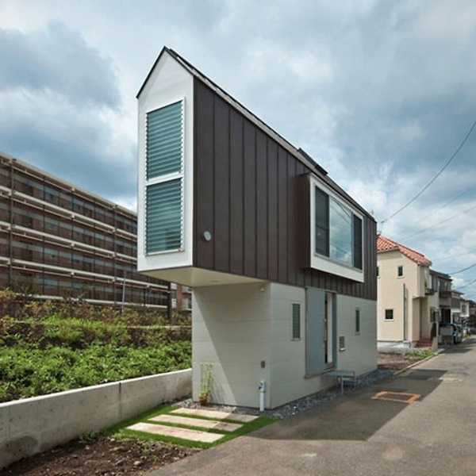
No yard house
Notes:
http://www.littlethings.com/triangle-tiny-house/

Slide 17
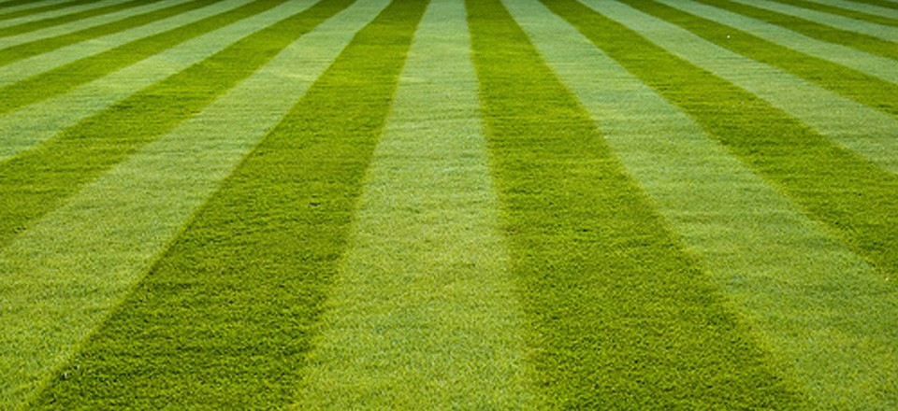
Jenkins, 1994,
Veblen (1899) characterized lawns as a classic form of conspicuous consumption. An occasional deer looked good on an otherwise empty lawn because it meant owners could afford an expanse of useless, decorative grass. Since live deer could not be assured, some of the earliest lawn ornaments such as cast-iron stags were developed in this era.
Notes:
Jenkins, V. S. (1994). The lawn: History of an American obsession. Washington, DC: Smithsonian

Slide 18
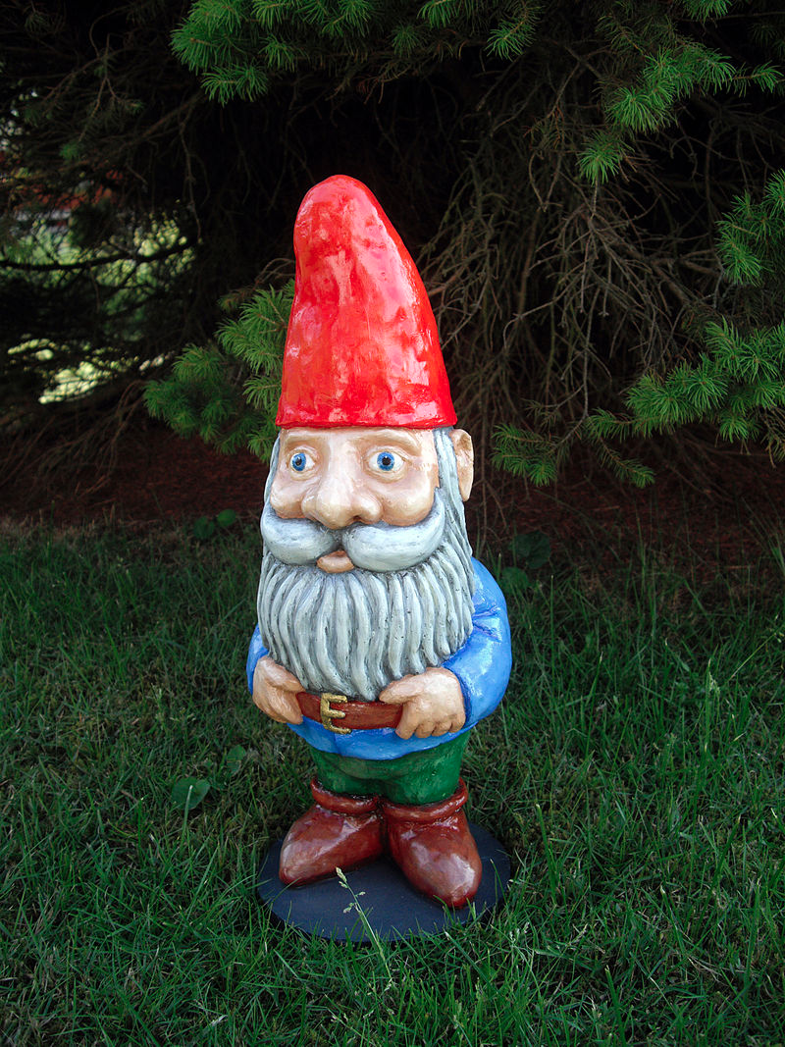
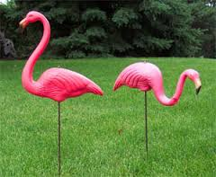
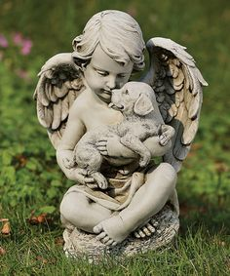
Notes:
The plastic pink flamingo was designed in 1957 by Don Featherstone while working for Union Products, and has become an icon of pop culture,[1] that won him the Ig Nobel Prize for Art in 1996. It has even spawned a lawn greeting industry where flocks of pink flamingos are installed on a victim's lawn in the dark of night. After the release of John Waters's 1972 movie Pink Flamingos,[2] plastic flamingos came to be the stereotypical example of lawn kitsch. (Wikipedia)
Garden Gnome by Bergsven CC BY SA 3.0 Wikimedia

Slide 19
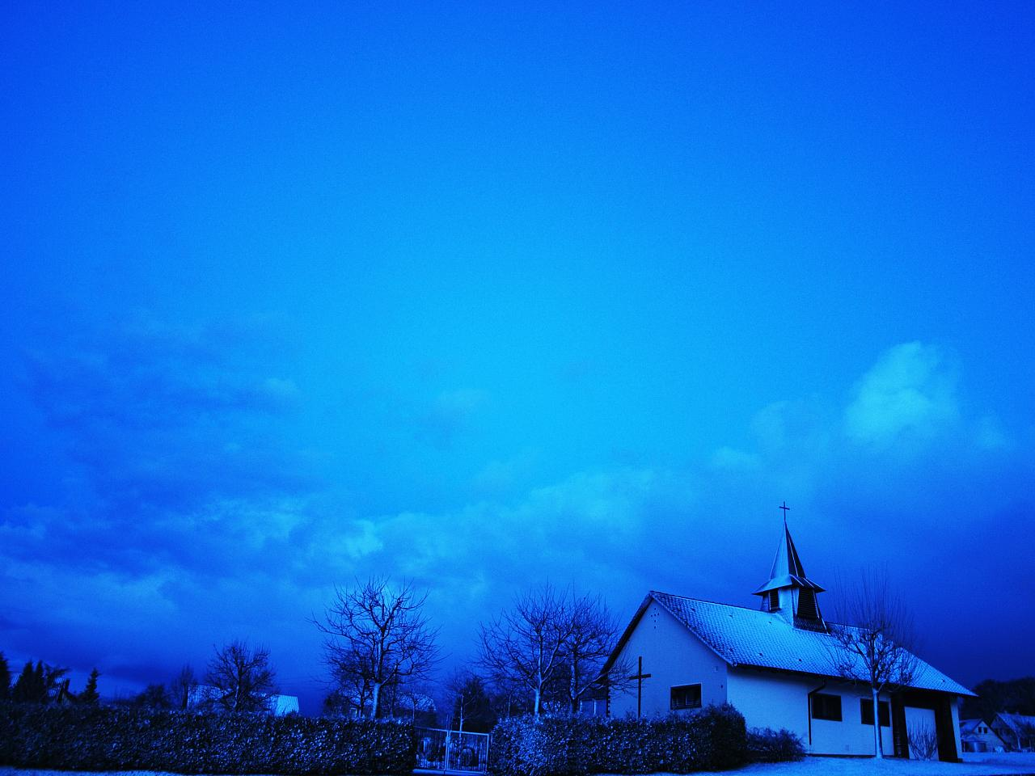
Boundaries: the door
I begin with the object that Simmel (1997, 170–73) has identified as “the image of the boundary point,” by which “the bounded and the boundaryless adjoin one another, not in the dead geometric form of a mere separating wall, but rather as the possibility of a permanent interchange.” Enter, the door. Or not
Christena Nippert-Eng Islands of Privacy (2010)
Notes:
Christena Nippert-Eng Islands of Privacy (2010)

Slide 20
Latour - Doors
Walls are a nice invention, but if there were no holes in them there would be no way to get in or out—they would be mausoleums or tombs. The problem is that if you make holes in the walls, anything and anyone can get in and out (cows, visitors, dust, rats, noise—La Halle aux Cuirs is ten meters from the Paris ring road—and, worst of all, cold—La Halle aux Cuirs is far to the north of Paris). So architects invented this hybrid: a wall hole, often called a door, which although common enough has always struck me as a miracle of technology. The cleverness of the invention hinges upon the hingepin: instead of driving a hole through walls with a sledgehammer or a pick, you simply gently push the door (I am supposing here that the lock has not been invented—this would overcomplicate the already highly complex story of La Villette’s door); furthermore—and here is the real trick—once you have passed through the door, you do not have to find trowel and cement to rebuild the wall you have just destroyed: you simply push the door gently back (I ignore for now the added complication of the ‘‘pull’’ and ‘‘push’’ signs).
Notes:
Bruno Latour, “Where Are the Missing Masses? The Sociology of a Few Mundane Artifacts,” in Shaping Technology/Building Society: Studies in Sociotechnical Change, ed. Wiebe E. Bijker and John Law (Cambridge, MA: MIT Press, 1992).

Slide 21
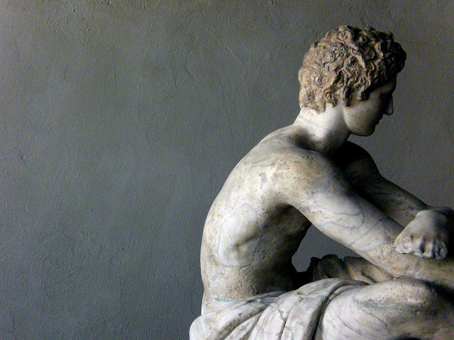
What do you do at home when the doorbell rings?
Before & after the cell phone.
Notes:
corpo di marmo by federico borghi cc by sa

Slide 22
In the simple act of someone ringing a doorbell, the problem of social accessibility once again rears its head. Screening phone calls may make some participants feel a bit guilty in terms of hiding their actual physical availability to answer the phone and respond to a caller’s request for attention. But for most of these same people, failing to answer the door when one is home and physically capable of doing so is truly grounds for a stricken conscience. A diminished, possibly lost relationship awaits if the caller on the doorstep sees evidence that the resident is at home, doesn’t appear hindered in their ability to answer the door, and yet still makes no attempt to do so.
Christena Nippert-Eng Islands of Privacy (2010)

Slide 23
Halloween is a lovely opportunity to examine the obligation to be socially accessible to whoever shows up at the door. It is a stark exception to everyday life in some ways. Yet, as this resident implies, participating in trick-or-treating festivities may simply amplify a preexisting social norm in which we are expected to answer the door when someone knocks—and, in general, not to feel overburdened by that obligation.
Christena Nippert-Eng Islands of Privacy (2010)

Slide 24
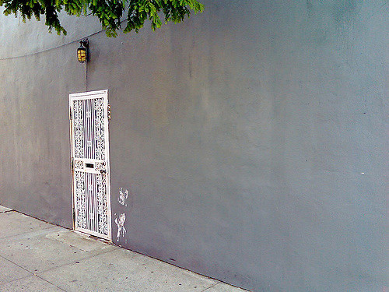
Back doors
Good friends, neighbors, and any others who regularly drop by may well be told to “just come around back” when they drop by. Such familiar visitors may even be admonished for coming to the front door and ringing the bell “like a stranger”—as if they don’t know the resident well enough to move past such formalities.

Slide 25
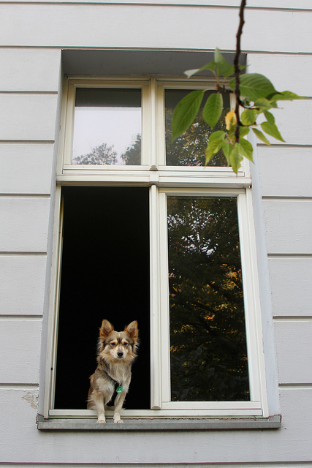
Windows are a point of vulnerability in maintaining one’s privacy in two ways. First, and perhaps most obviously, a window is not a door. It is much more easily broken and a building is more easily broken into via a window than a door. People forget to close and lock windows far more than doors, too. From this perspective, windows are a security problem, potentially leading to unexpected and profound senses of privacy violations among participants.
Nippert-Eng (2010)
Notes:
Shaggy Dog by Wrote CC BY NC

Slide 26
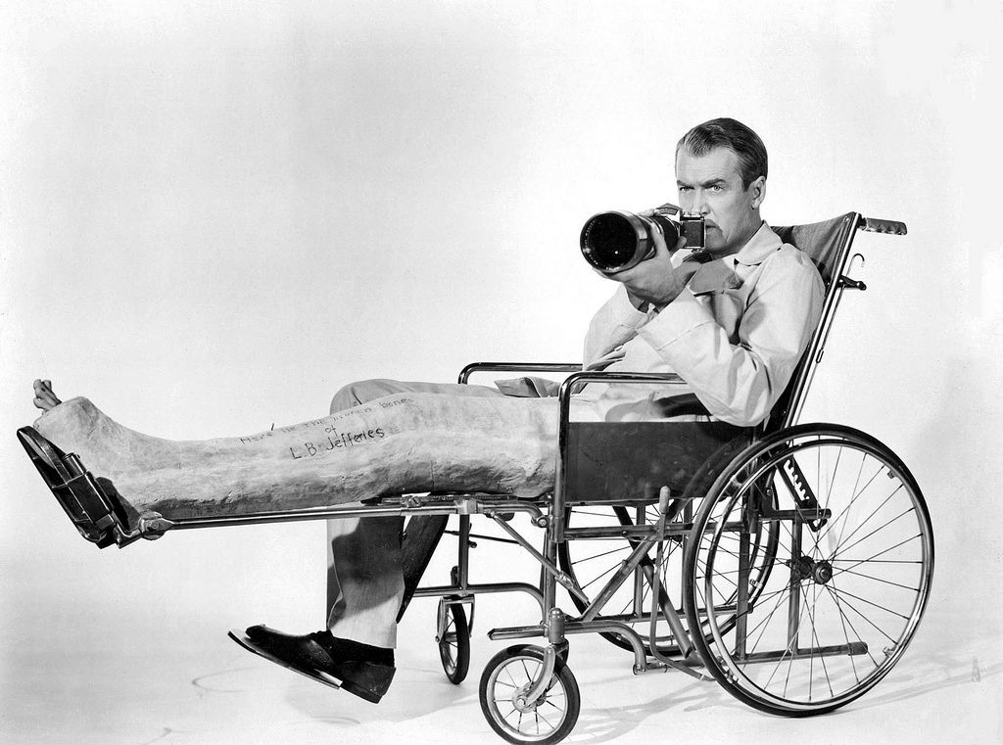
How to feel about drapes?
Rear Window
Hitchcock 1954

Slide 27
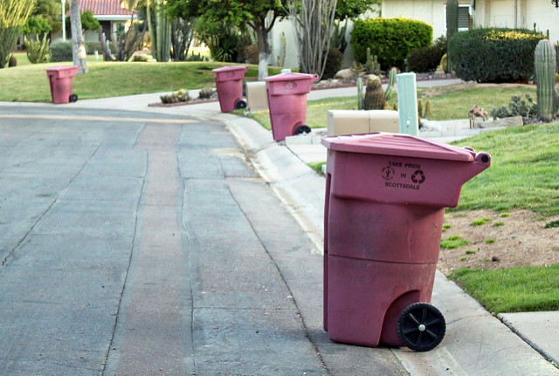
Taken altogether, then, garbage is spread across the private-public continuum, emerging as a hybrid category that has many subcategories.
Garbage is a private/public hybrid in a second sense, too. Like credit cards, money, or business cards, participants often define various components of a single piece of garbage as more and less public. Specific, selective behaviors to protect the most private bits emerge as a result of this. Along with credit card numbers and financial account information, names and addresses are among some of the most common parts of trash to besingled out for secrecy behaviors.
Notes:
Recycle Day in Scottsdale by Dru Bloomfield cc by.jpg

Slide 28
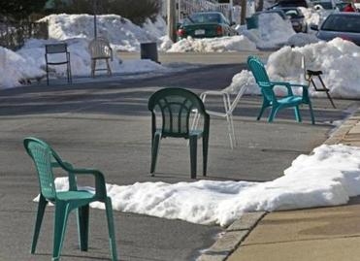
Your spot? Street Parking
In order to park one’s car, an individual shovels the snow out of an appropriate-sized space (or waits until someone else does), then claims that portion of the (very public) street as one’s own. One does this either by keeping one’s car in that space until the thaw or by putting an assortment of semidisposable, “private” household items in its place whenever one moves the car.

Slide 29
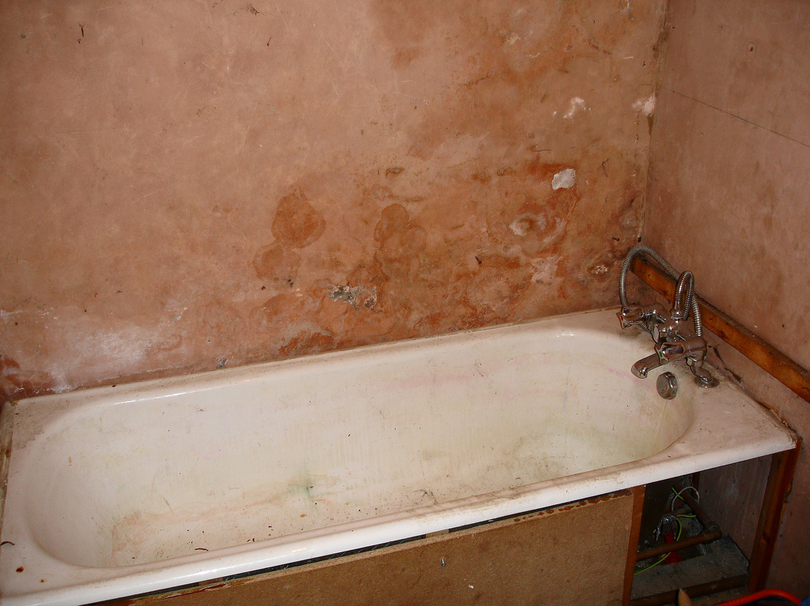
Our stuff our privacy?
Notes:
Dirty old bath from net_efekt cc by nc sa

Slide 30
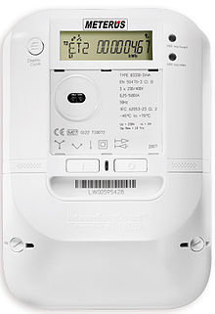
Smart electricity meters
Notes:
A smart meter is usually an electronic device that records consumption of electric energy in intervals of an hour or less and communicates that information at least daily back to the utility for monitoring and billing. Smart meters enable two-way communication between the meter and the central system.

Slide 31
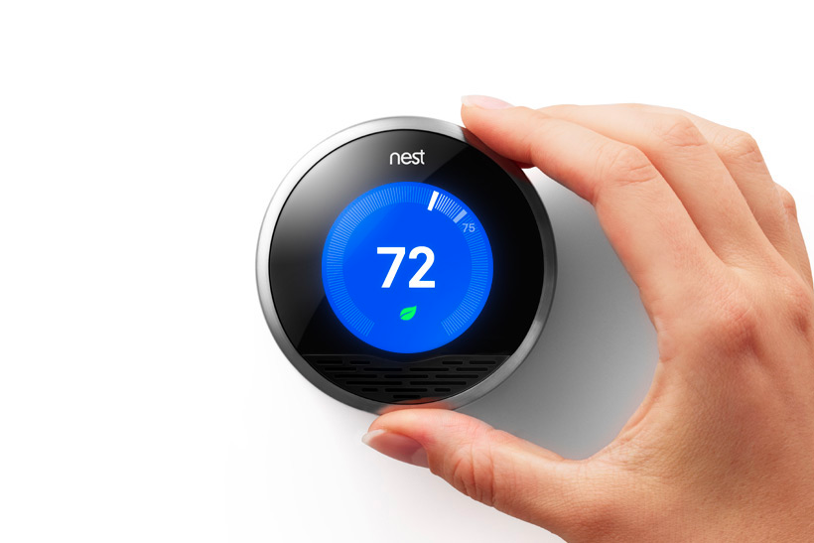
Smart homes (Nest and other automation)
Notes:
Nest Labs is a home automation producer of programmable, self-learning, sensor-driven, Wi-Fi-enabled thermostats, smoke detectors, and other security systems.

Slide 32
Streaming devices

Slide 33
Samsung smart TV

Slide 34
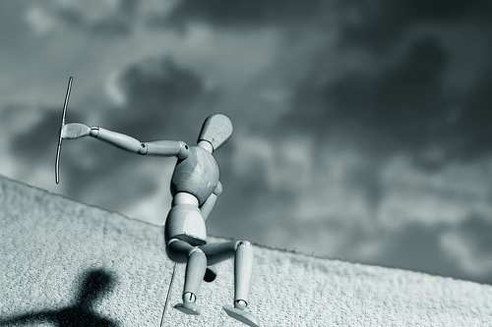
OTHER STUFF
Notes:
Death of a surrealist soldier from funadium cc by nc sa

Slide 35
Fourth Amendment
The right of the people to be secure in their persons, houses, papers, and effects, against unreasonable searches and seizures, shall not be violated, and no Warrants shall issue, but upon probable cause, supported by Oath or affirmation, and particularly describing the place to be searched, and the persons or things to be seized.

Slide 36
Article 8 of the European Convention for the Protection of Human Rights and Fundamental Freedoms
“Everyone has the right to respect for his private and family life, his home and his correspondence.”

Slide 37
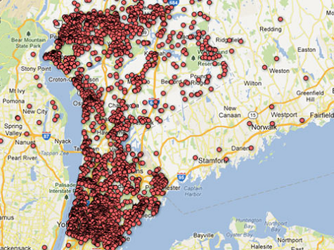
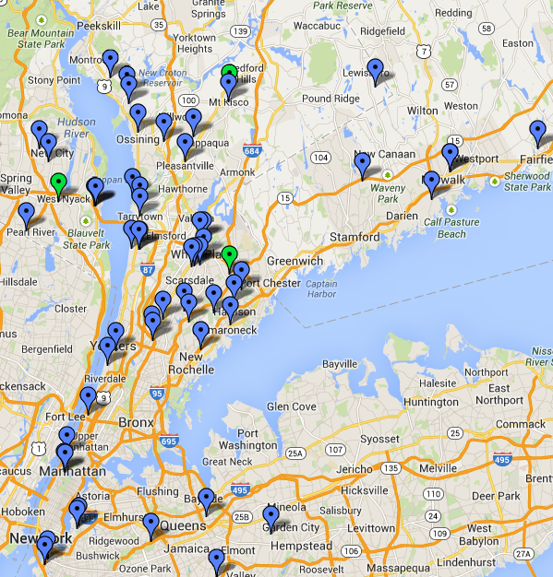
In the aftermath of the Sandy Hook shootings, a local newspaper published a map of homes of neighborhood gun owners.
In response, gun owners published a map marking the homes of the journalists who wrote for that paper.
Notes:
http://www.newrochelletalk.com/content/map-where-are-journal-news-employees-your-neighborhood
http://www.complex.com/tech/2012/12/local-newspaper-posts-an-interactive-map-of-gun-owners-names

Slide 38
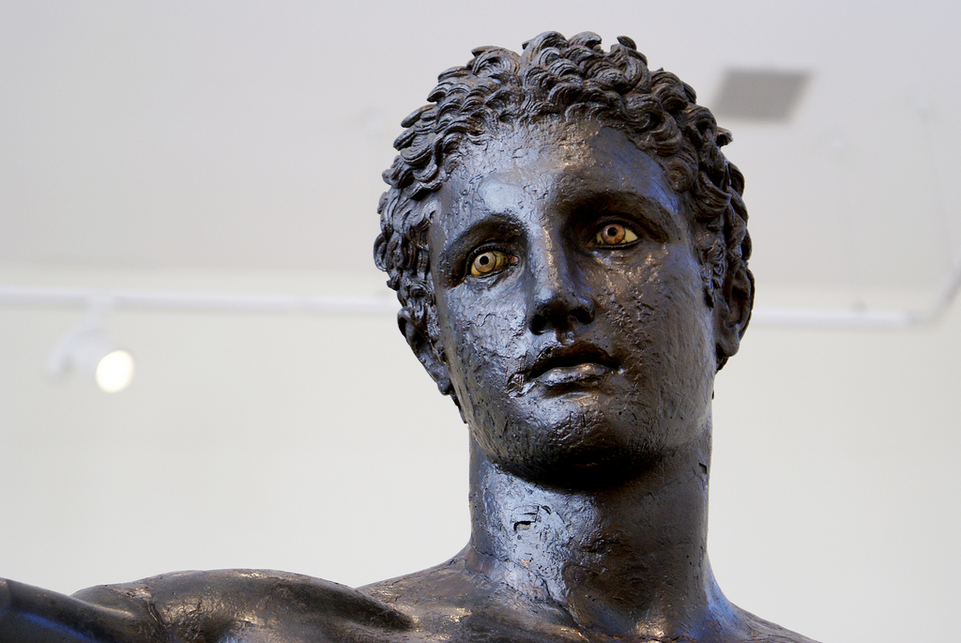
Thank you!
Notes:
Eyes ! (Youth from Antikythera!) by agelakis cc by nc sa

Slide 39
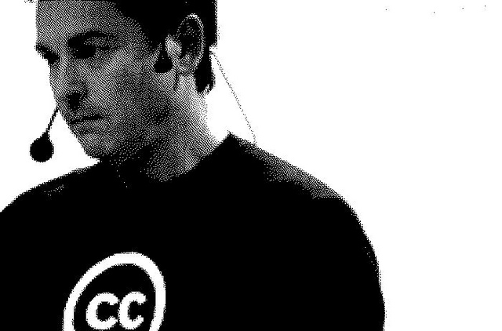
Mathias Klang
@klangable
www.klangable.com
Image & licensing info in the notes section of slides.
Images at www.flickr.com (or specifically stated).
This ppt licensed: Creative Commons BY-NC-SA
Download presentation
www.slideshare.net/klang

