Slide 1
Open Content Culture
Mathias Klang
klang@umb.edu
@klangable
Notes:
my wallpaper by baboon™ cc by nc

Slide 2
Open Source is a development methodology: Free Software is a social movement
-Richard Stallman

Slide 3
What is an operating system?
“technical means to a social end”
Notes:
Ω by RawheaD Rex CC BY NC SA

Slide 4
Source code?
Notes:
Stand Out from The Crowd Unique Golf Tee Game September 19, 20119 by Steven Depolo CC BY

Slide 5
Is Free Software a movement?
Notes:
Got milk? from OLD SKOOL Cora cc by nc sa

Slide 6
Social movements are conscious, concerted, and sustained efforts by ordinary people to change some aspect of their society by using extra-institutional means
-Goodwin & Jasper, 2014 p3

Slide 7
Birth of Free Software
Notes:
Why I'm Going to Work for Zooomr from Thomas Hawk cc by nc

Slide 8
Starting this Thanksgiving I am going to write a complete Unix-compatible software system called GNU (for Gnu's Not Unix), and give it away free to everyone who can use it. Contributions of time, money, programs and equipment are greatly needed.
-Richard Stallman (1984)

Slide 9
Stallman Definition of Free https://youtu.be/Tt3bjUDqJGM
Notes:
Richard Stallman on the definition of free software
https://youtu.be/Tt3bjUDqJGM

Slide 10
GNU is not in the public domain. Everyone will be permitted to modify and redistribute GNU, but no distributor will be allowed to restrict its further redistribution. That is to say, proprietary modifications will not be allowed. I want to make sure that all versions of GNU remain free.
-GNU Manifesto (1985)

Slide 11
The Four Freedoms
The freedom to run the program as you wish, for any purpose (freedom 0).
The freedom to study how the program works, and change it so it does your computing as you wish (freedom 1).
Access to the source code is a precondition for this. The freedom to redistribute copies so you can help your neighbor (freedom 2).
The freedom to distribute copies of your modified versions to others (freedom 3).

Slide 12
Enforcing Free
licensing
Notes:
Music from naturegeak cc by

Slide 13
The Linux philosophy is 'Laugh in the face of danger'. Oops. Wrong One. 'Do it yourself'. Yes, that's it.
-Linus Torvalds

Slide 14
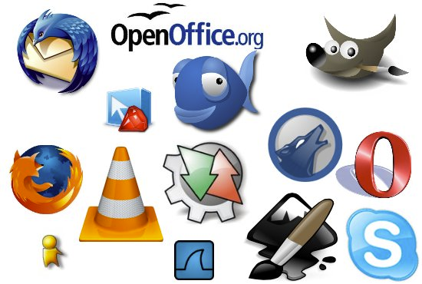
Open source software

Slide 15
Creative Commons
Cultural production
Notes:
creative commons -Franz Patzig- from A. Diez Herrero cc by nc sa

Slide 16
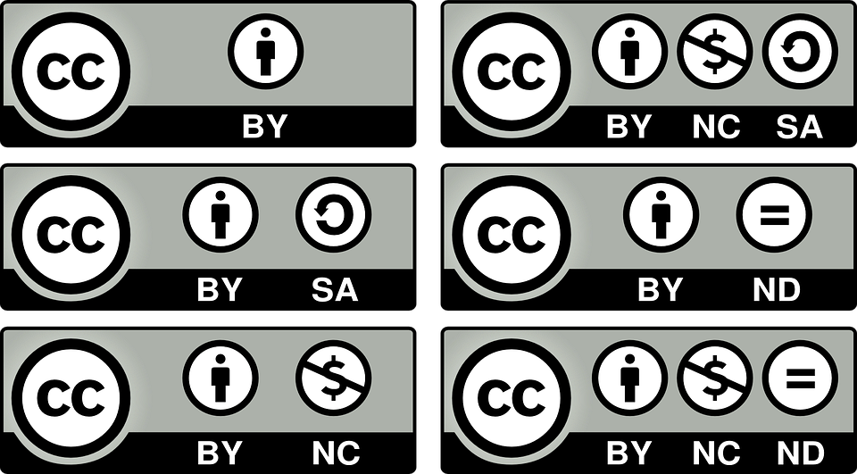

Slide 17
The future of our right to tinker?

Slide 18
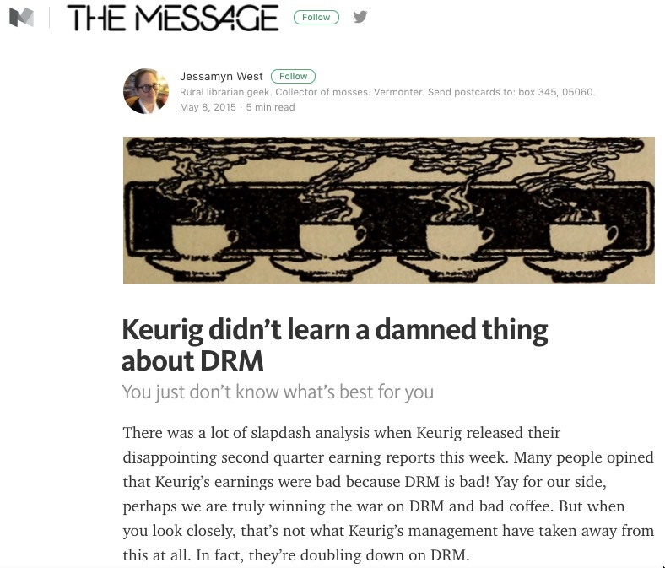
Notes:
Keurig didn’t learn a damned thing about DRM
https://medium.com/message/keurig-didn-t-learn-a-damned-thing-about-drm-972912b13243#.rrbteyxbq

Slide 19
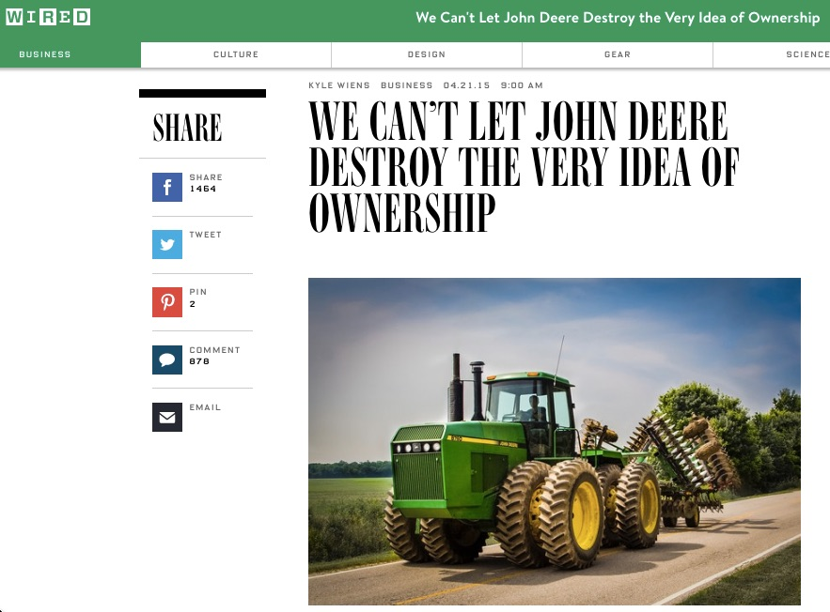
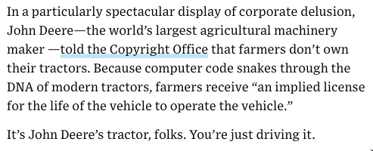
Notes:
We Can’t Let John Deere Destroy the Very Idea of Ownership
https://www.wired.com/2015/04/dmca-ownership-john-deere/

Slide 20
The Web as FLOSS
How is the web created?
Notes:
learning by Mathias Klang CC BY NC

Slide 21
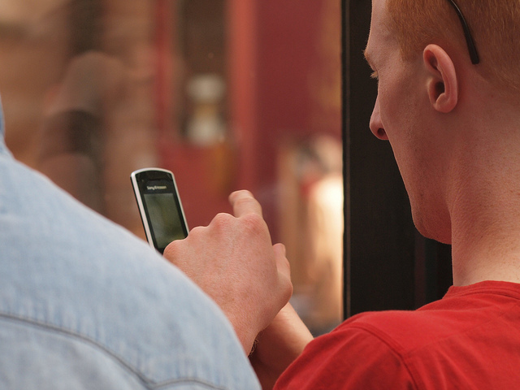
the daily me
Nicholas Negroponte
discusses it in his 1995 book,
Being Digital
Notes:
P4307229.ORF By Sigfrid Lundberg cc by sa

Slide 22
Notes:
The Rise of the Daily Me Threatens democracy
Cass Sunstein

Slide 23
In media, an echo chamber is a situation in which information, ideas, or beliefs are amplified or reinforced by transmission and repetition inside an "enclosed" system, where different or competing views are censored, disallowed, or otherwise underrepresented.
-Wikipedia

Slide 24
Notes:
Filter bubbles, echo chambers and online news consumptions
Flaxman, Goel, & Rao

Slide 25
Cheap & Free: The bait & Switch of the App Economy

