Slide 1
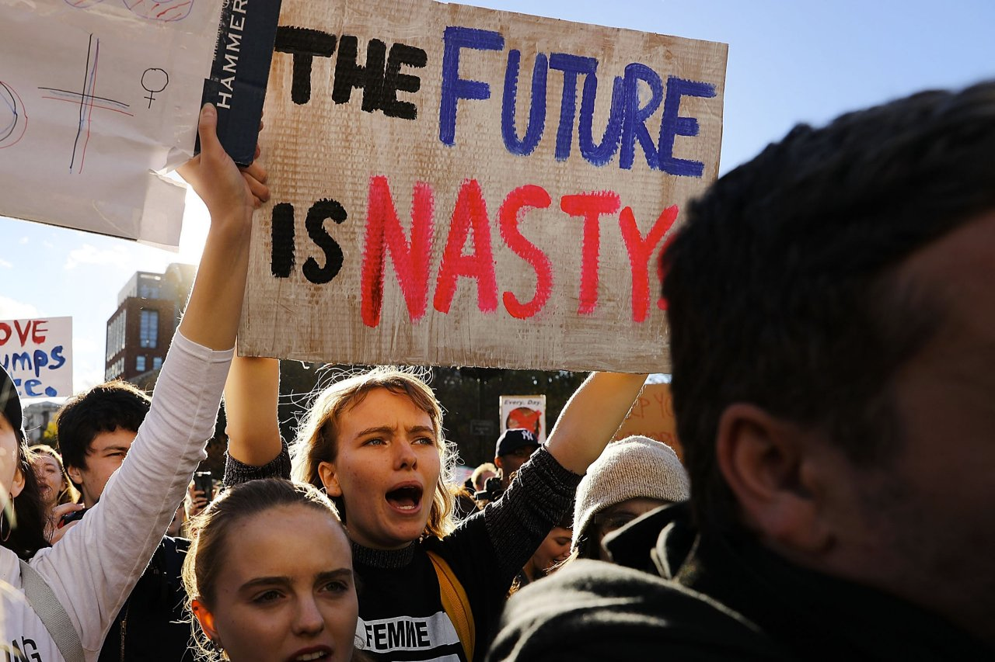
Protest Works!
Mathias Klang
@klangable
klang@umb.edu

Slide 2
the message: Longer, Louder, Unignorable

Slide 3
Unite protests

Slide 4
Diversify actions

Slide 5
Protest proactively

Slide 6
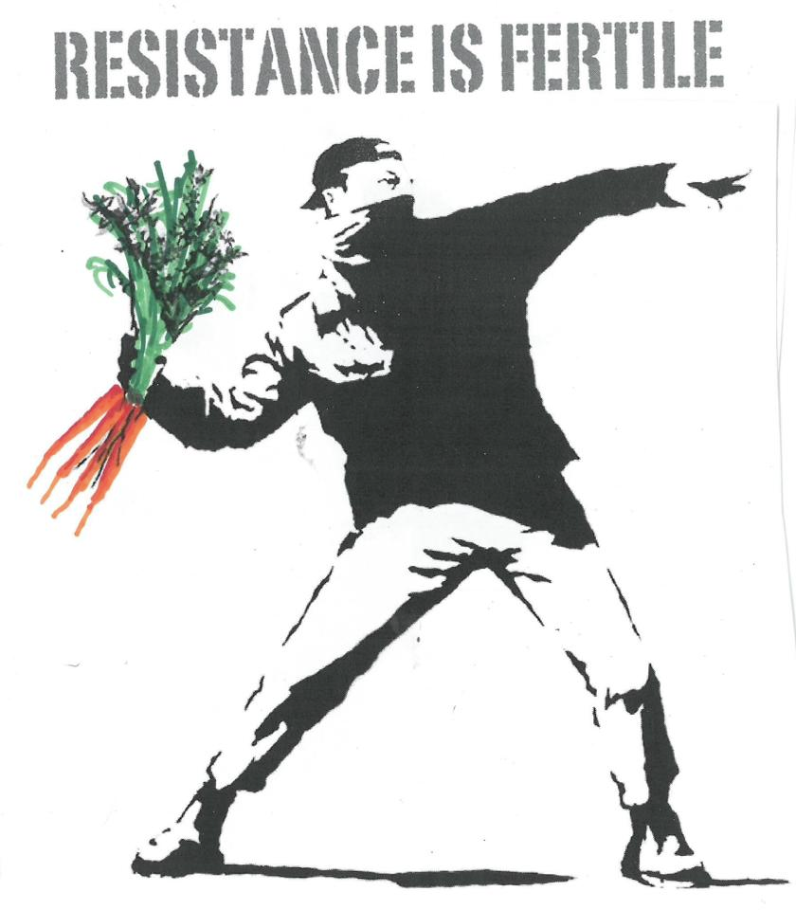
Everyday Activism

Slide 7
Social movements are conscious, concerted, and sustained efforts by ordinary people to change some aspect of their society by using extra-institutional means
-Goodwin & Jasper, 2014

