Slide 1
Technology & death
“it isn’t real until it’s on facebook”
Mathias Klang @klangable klang@umb.edu
Notes:
lisa moyer, ph.d.
eastern illinois university
suzanne enck, ph.d.
university of north texas

Slide 2
Augmenting deatH
“Cybermemorials” and “virtualcemeteries” have been around since 1996. They include both static content (profiles that resemble an obituary) and dynamic content (“guestbooks” that allow visitors to add content to the site).

Slide 3
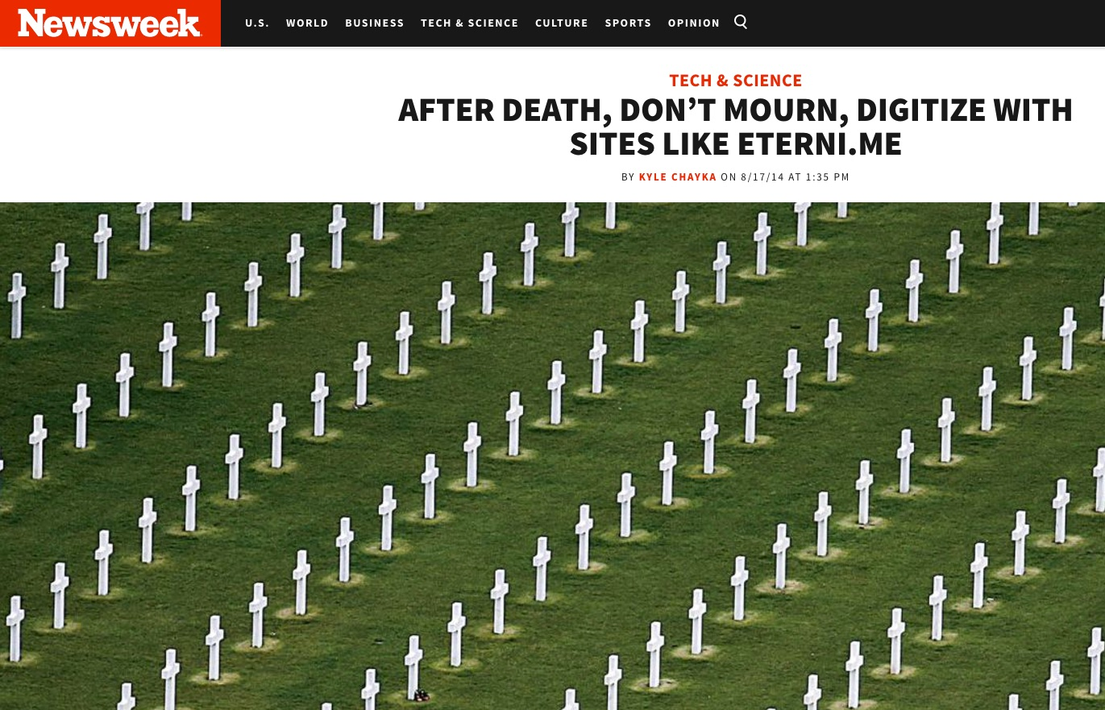
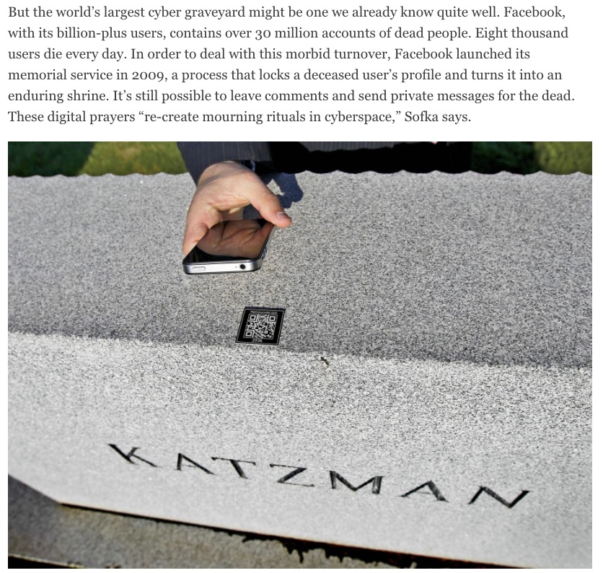
Notes:
AFTER DEATH, DON’T MOURN, DIGITIZE WITH SITES LIKE ETERNI.ME
http://www.newsweek.com/2014/08/29/after-death-dont-mourn-digitize-sites-eternime-264892.html

Slide 6
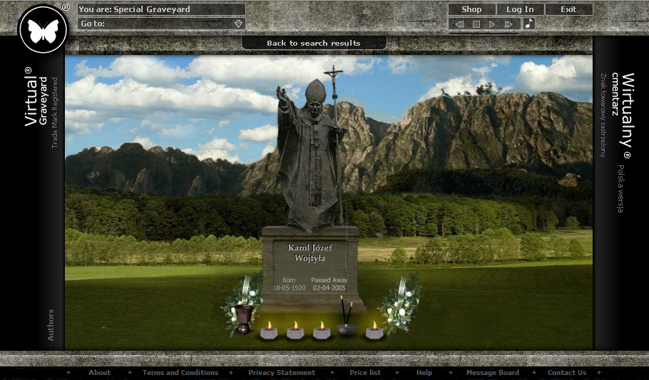
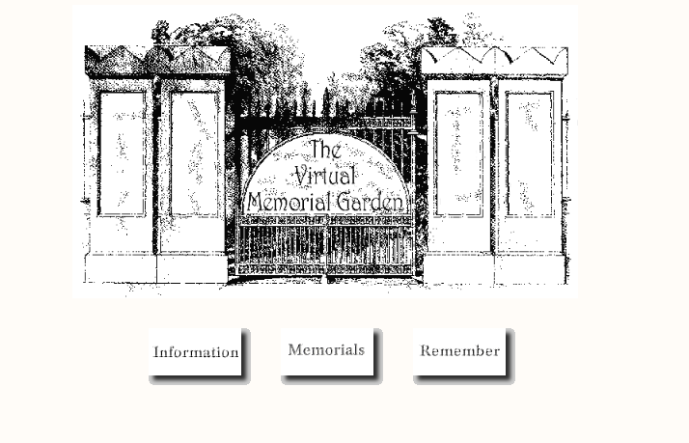
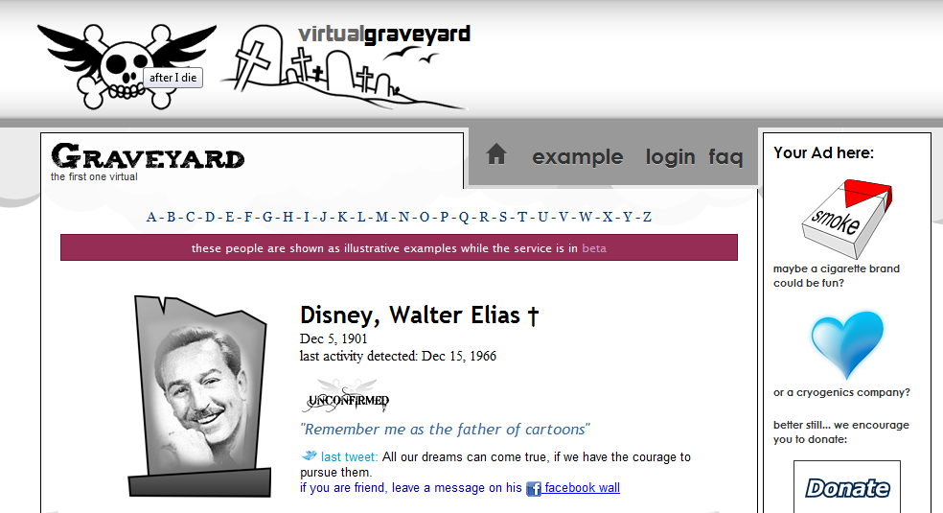
http://virtualgrave.eu/
http://catless.ncl.ac.uk/vmg/
http://www.afteridie.org/graveyard

Slide 7
But also

Slide 8
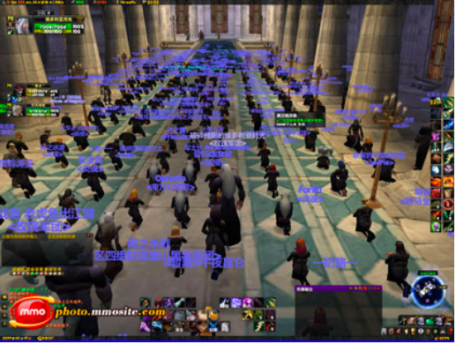
Memorial Services in Online Role-Playing Games (case of World of Warcraft)
Picture: http://news.mmos.com/content/2009-12-03/20091203015408595,1.shtml#ue_pic

Slide 9
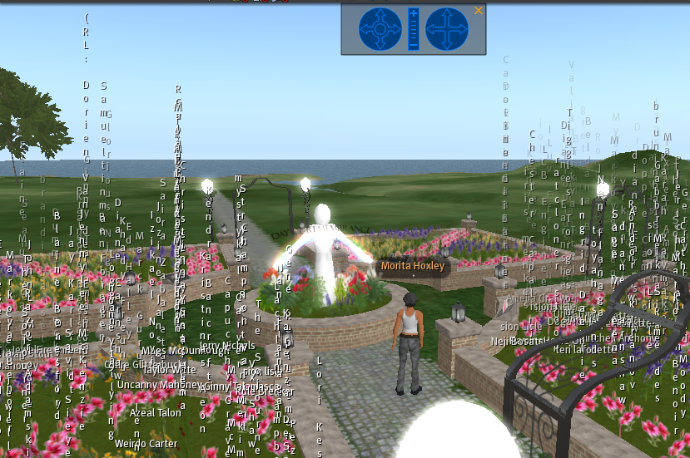
Memorial Services in Online Role-Playing Games (case of Second Life)
Picture: Anna Haverinen, screenshot, 19.3.2010.

Slide 10
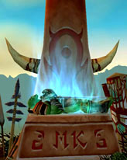
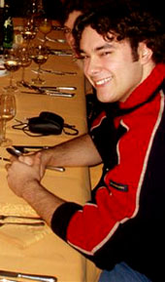
Shrine of the Fallen Warrior (case of World of Warcraft)
Pictures: http://www.wowwiki.com/Michel_Koiter

Slide 11
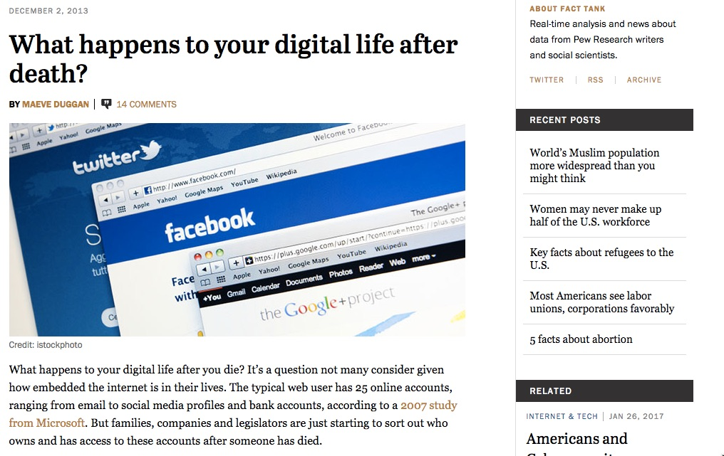
Notes:
What happens to your digital life after death?
http://www.pewresearch.org/fact-tank/2013/12/02/what-happens-to-your-digital-life-after-death/

Slide 12
Adam Ostrow: After your final status update
https://youtu.be/D03n5dAmBSE

Slide 13
Compassion

Slide 14
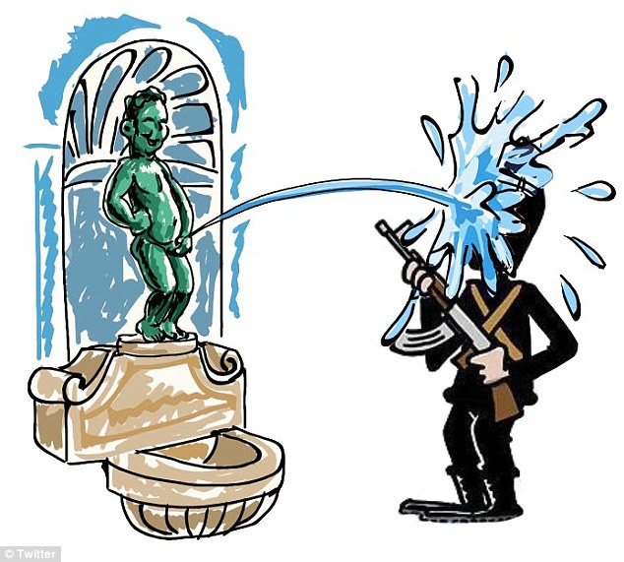
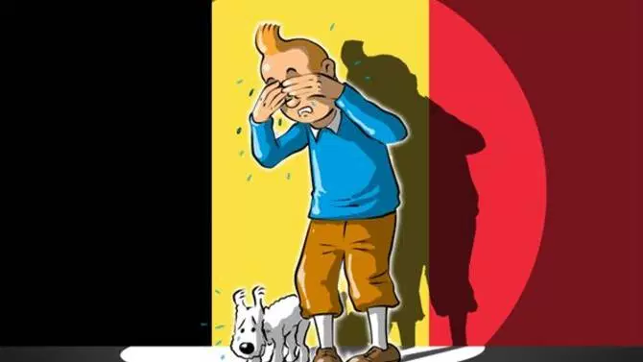
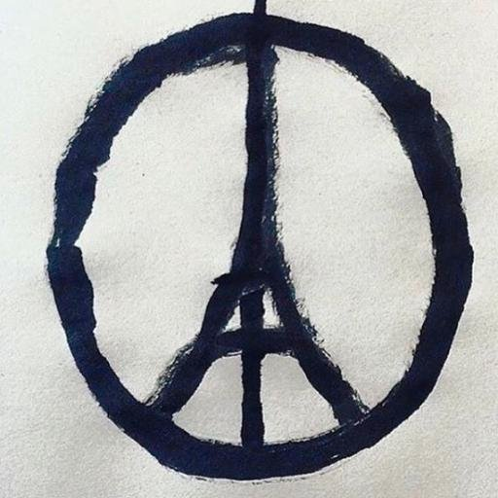
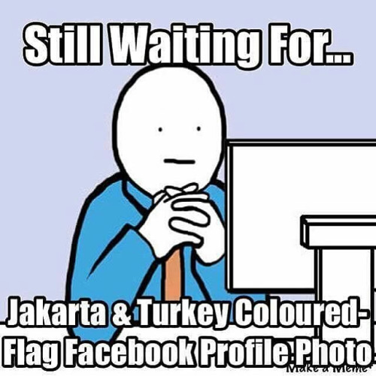
Social media compassion

Slide 15
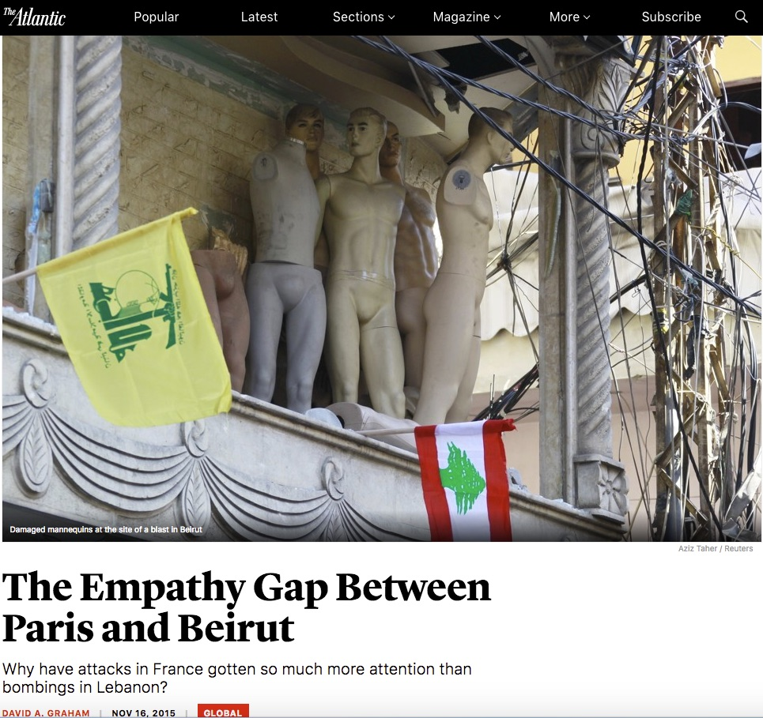
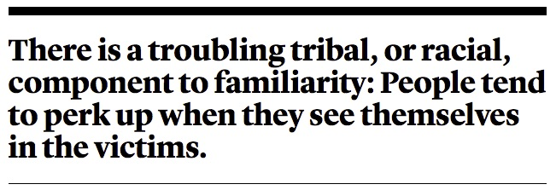
Notes:
The Empathy Gap Between Paris and Beirut
https://www.theatlantic.com/international/archive/2015/11/paris-beirut-terrorism-empathy-gap/416121/

Slide 16
Notes:
The Empathy Gap Between Paris and Beirut
https://www.theatlantic.com/international/archive/2015/11/paris-beirut-terrorism-empathy-gap/416121/

Slide 17
Mourning

Slide 18
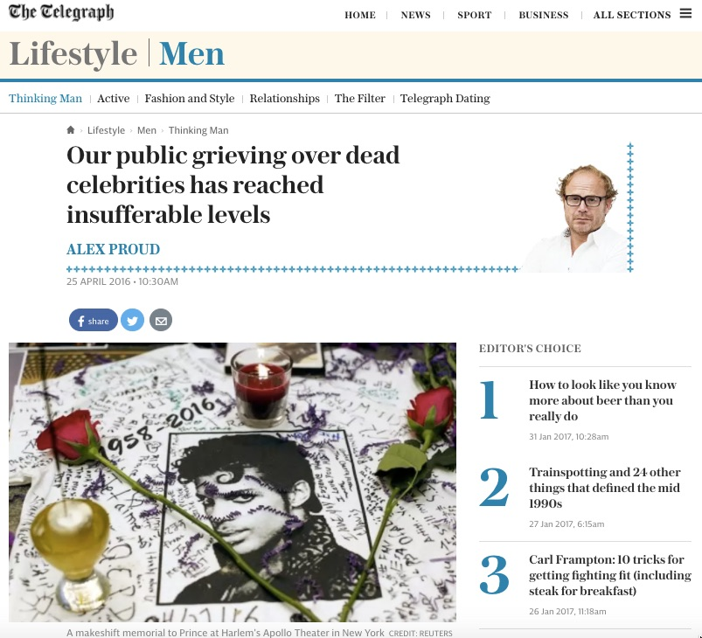
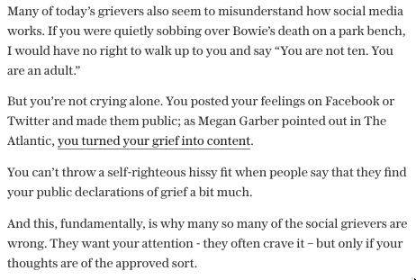
Notes:
Our public grieving over dead celebrities has reached insufferable levels
http://www.telegraph.co.uk/men/thinking-man/our-public-grieving-over-dead-celebrities-has-reached-insufferab/

Slide 19
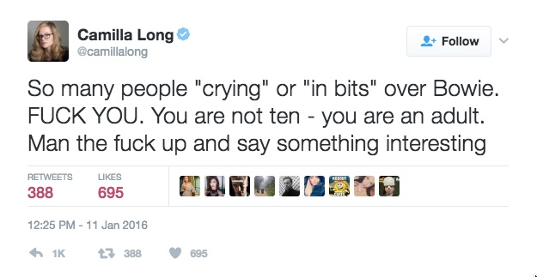
Notes:
https://twitter.com/camillalong/status/686599844060901378?lang=en

Slide 20
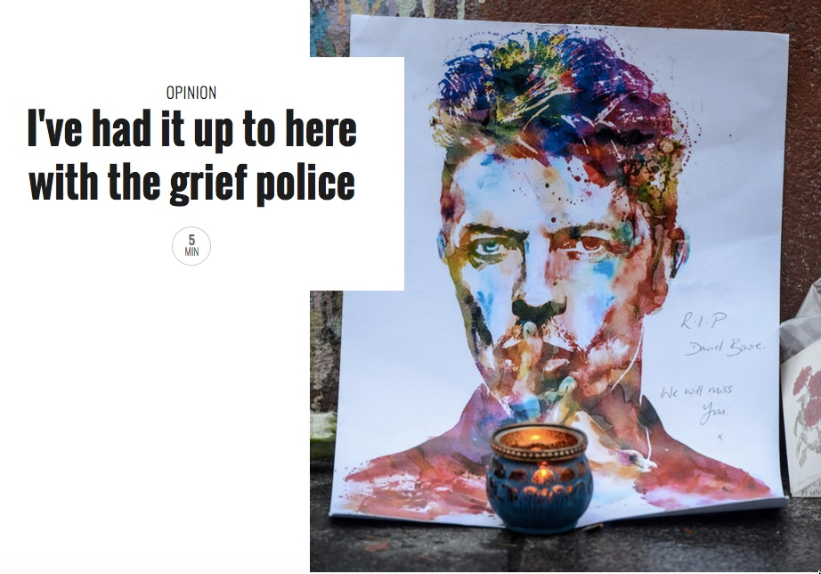
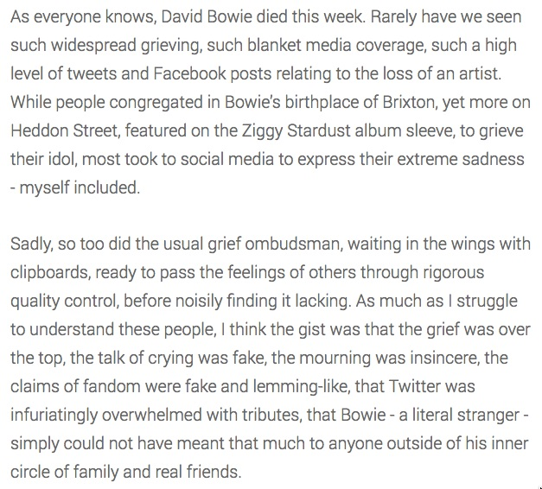
Notes:
I've had it up to here with the grief police
https://www.the-pool.com/news-views/opinion/2016/2/sali-hughes-on-the-bowie-grief-police

Slide 21
Notes:
http://www.salon.com/2013/12/06/the_power_of_communal_grief_mourning_mandela_and_beyond/

Slide 22
Notes:
On social media and collective mourning http://www.politico.com/blogs/media/2014/08/on-social-media-and-collective-mourning-193800

Slide 23
http://www.nybooks.com/articles/2010/11/25/generation-why/

Slide 25
Funeral Selfies: The final straw?

Slide 27
Teenagers Are Taking Selfies At Funerals — And A New Tumblr Has The Entire Cringeworthy Collection http://www.businessinsider.com/selfies-at-funerals-tumblr-2013-10

Slide 28
Notes:
http://www.theatlantic.com/entertainment/archive/2016/01/enter-the-grief-police/424746/

Slide 29
Notes:
http://www.theatlantic.com/entertainment/archive/2016/01/enter-the-grief-police/424746/

Slide 30
A Passionate Defense of Selfies at Funerals http://jezebel.com/a-passionate-defense-of-selfies-at-funerals-1455095190

Slide 31
A Passionate Defense of Selfies at Funerals
Are these particular teenagers missing the etiquette train by posting funeral selfies? Absolutely. But just like most teenagers in 2013 have never ridden on a train, forget the metaphorical etiquette train, statistically they've never been to a funeral either. Not a single article has mentioned the reason that "Selfies at Funerals"—regardless of Feifer's humorous intentions— is actually scathing cultural commentary: our tragic disengagement with the reality of death.

Slide 32
A Passionate Defense of Selfies at Funerals
What if we gave our duckfaced n'er do wells the obligation to engage with the real processes of death, to remind them that when someone dies that there is a real corpse and real grief left behind. Death is not an abstract concept. They could take part in a physical and emotional ritual beyond awkwardly lining up to file by an embalmed and made up body the funeral director has laid out under rose colored lights. No wonder these teenagers retreat to the bathroom to fix their hair and take a selfie in the mirror out of impotence and boredom. Our cultural traditions have failed them, and selfies at funerals are one of their only outlets to ritual and mourning in the age of the smartphone.

Slide 33
http://www.nytimes.com/2014/03/23/fashion/an-online-generation-redefines-mourning.html

Slide 34
Notes:
http://time.com/47252/mourning-social-media/

Slide 35
Death Tourism (and selfies)

Slide 38
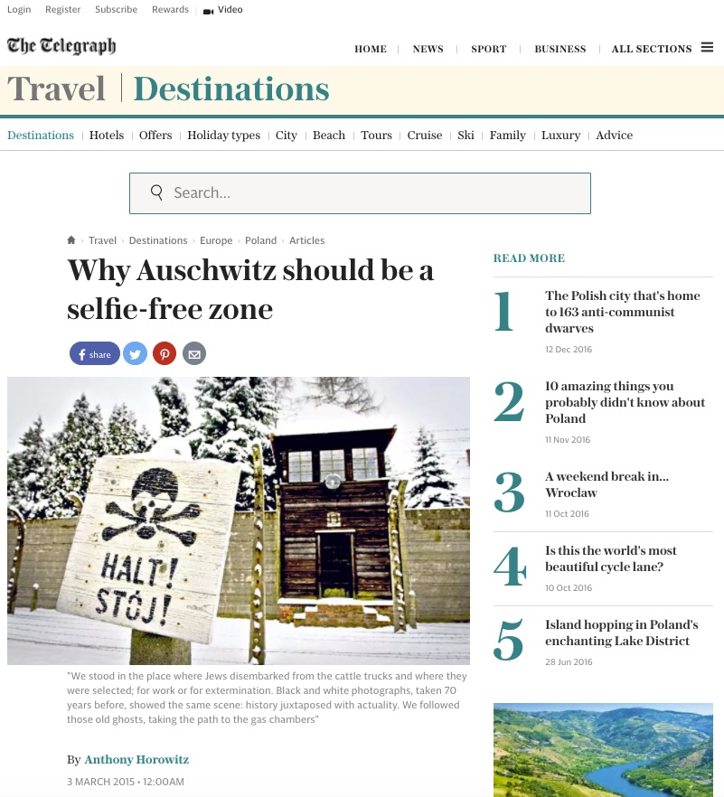
Notes:
Why Auschwitz should be a selfie-free zone http://www.telegraph.co.uk/travel/destinations/europe/poland/articles/Why-Auschwitz-should-be-a-selfie-free-zone/

Slide 39
Holocaust memorial Berlin
Berlin's Holocaust memorial, an unrelenting grid of 2,711 concrete slabs located near the Brandenburg Gate

Slide 42
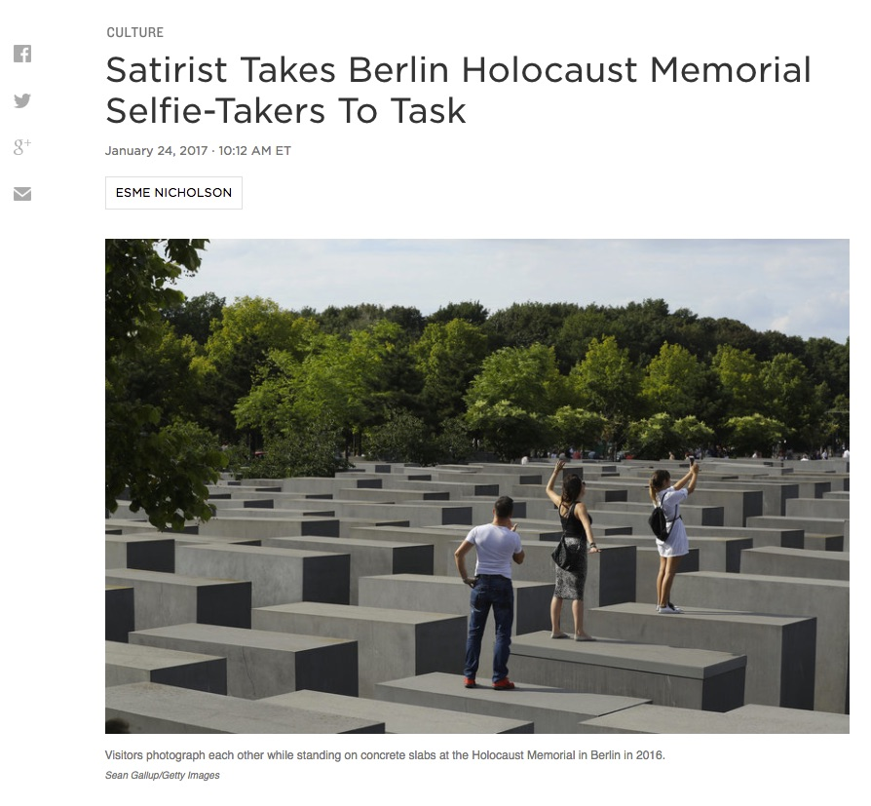
Notes:
Satirist Takes Berlin Holocaust Memorial Selfie-Takers To Task
http://www.npr.org/sections/parallels/2017/01/24/511244932/satirist-takes-berlin-holocaust-memorial-selfie-takers-to-task

Slide 43
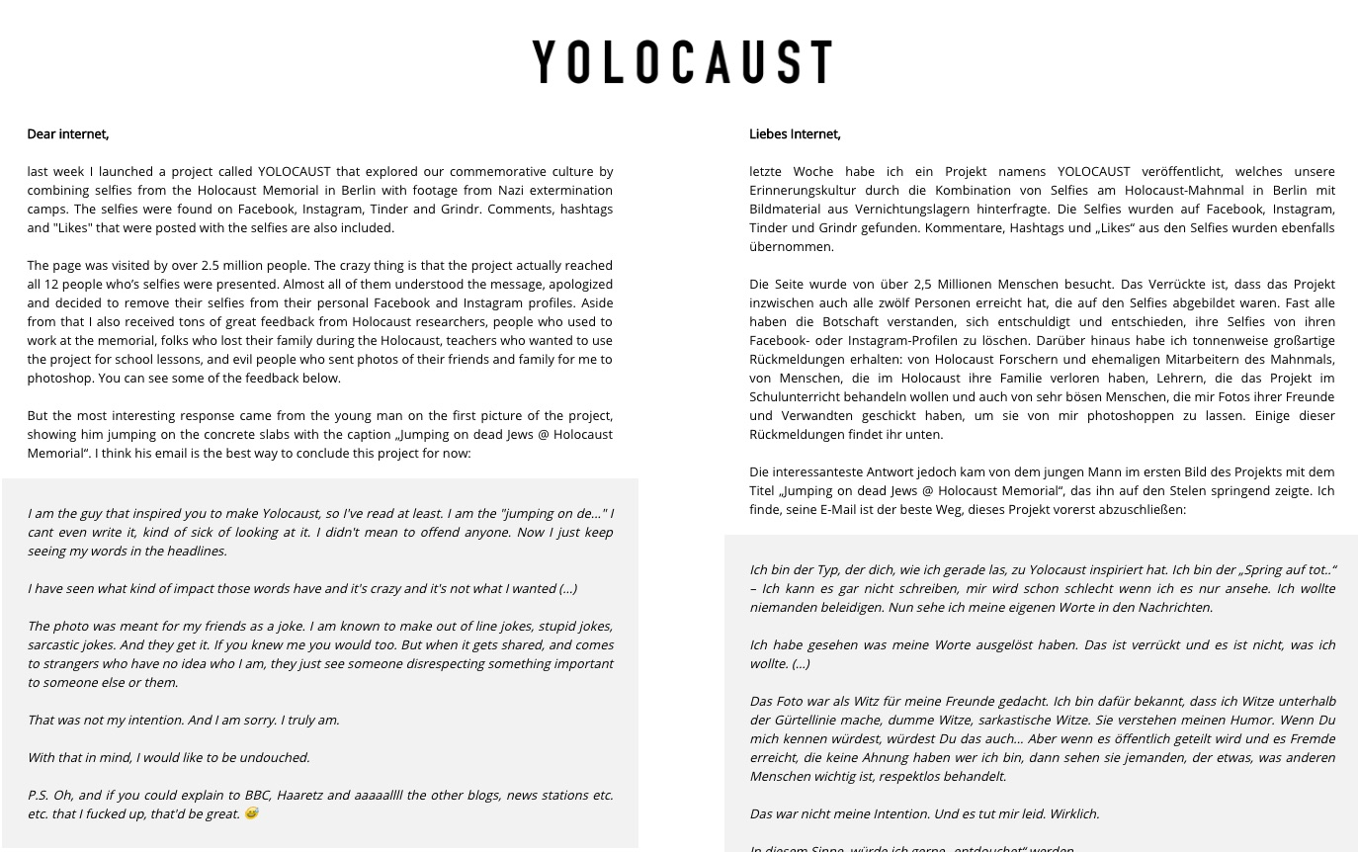
Notes:
http://yolocaust.de/

Slide 45
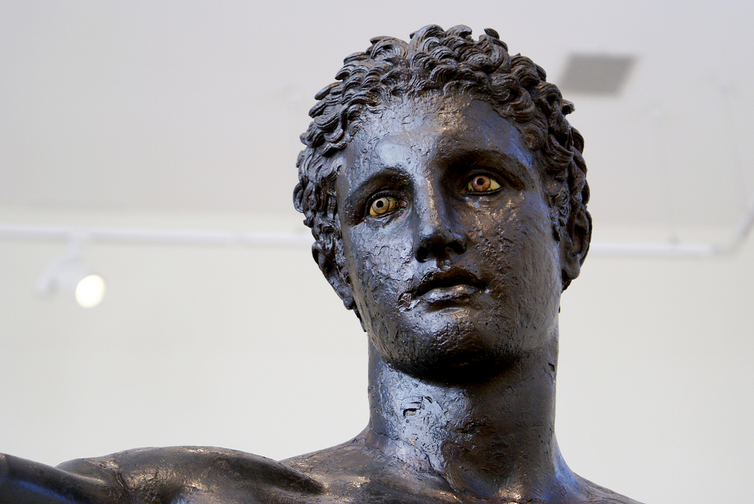
THANKS!
Notes:
Eyes ! (Youth from Antikythera!) by agelakis cc by nc sa

