Slide 1
Is the Internet a Public Space?
Mathias Klang
@klangable
Klang@umb.edu

Slide 2
What is a public sphere and why does it matter?

Slide 3
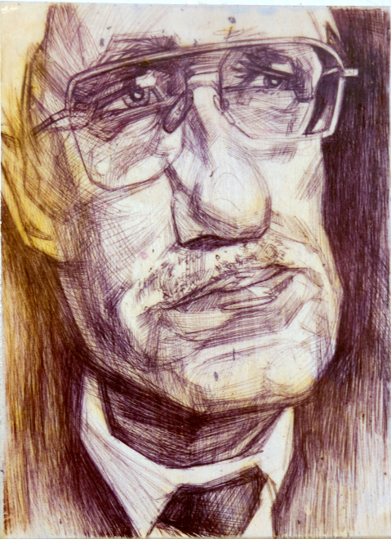
Jürgen Habermas (1929 - )
It came about in the 18th century with the rise of the middle class and the creation of associations, clubs, coffee houses, salons... People used to discuss poetry, philosophy, aesthetics, and social issues. Gradually they began to discuss matters of governance.
Notes:
CC Nic*Rad @ Flickr

Slide 4
Public Sphere
“that realm of social life where the exchange of information and views on questions of common concern can take place so that public opinion can be formed”

Slide 5
For the first time in history, individuals and groups could shape public opinion, giving direct expression to their needs and interests while influencing political practice. The bourgeois public sphere made it possible to form a realm of public opinion that opposed state power and the powerful interests that were coming to shape bourgeois society.

Slide 6
Success criterion for Public sphere
the extent of access (as close to universal as possible)
the degree of autonomy (the citizens must be free of coercion)
the rejection of hierarchy (so that each might participate on an equal footing)
the rule of law (particularly the subordination of the state)
and the quality of participation (the common commitment to the ways of logic)

Slide 7
Critique
Who were excluded?

Slide 8
The radio, television, and other electronic modes of communication were creating new public spheres of debate, discussion, and information; hence, activists and intellectuals who wanted to engage the public, to be where the people were at, and who thus wanted to intervene in the public affairs of their society should make use of these technologies and develop communication politics and new media projects.

Slide 9
Can the internet solve some of this?
- What is the Internet?

Slide 10
The Internet Is A Series Of Tubes Infographic https://youtu.be/mHpA4dkP1j8
Notes:
Senator Ted Stevens Series of Tubes https://en.wikipedia.org/wiki/Series_of_tubes
The Internet is not something you just dump something on. It's not a truck. It's a series of tubes. And if you don't understand, those tubes can be filled. And if they are filled, when you put your message in, it gets in line and it's going to be delayed by anyone that puts into that tube enormous amounts of material, enormous amounts of material.

Slide 11
Senator Ted Stevens (2006) Series of Tubes
The Internet is not something you just dump something on. It's not a truck. It's a series of tubes. And if you don't understand, those tubes can be filled. And if they are filled, when you put your message in, it gets in line and it's going to be delayed by anyone that puts into that tube enormous amounts of material, enormous amounts of material.
Notes:
https://en.wikipedia.org/wiki/Series_of_tubes

Slide 12
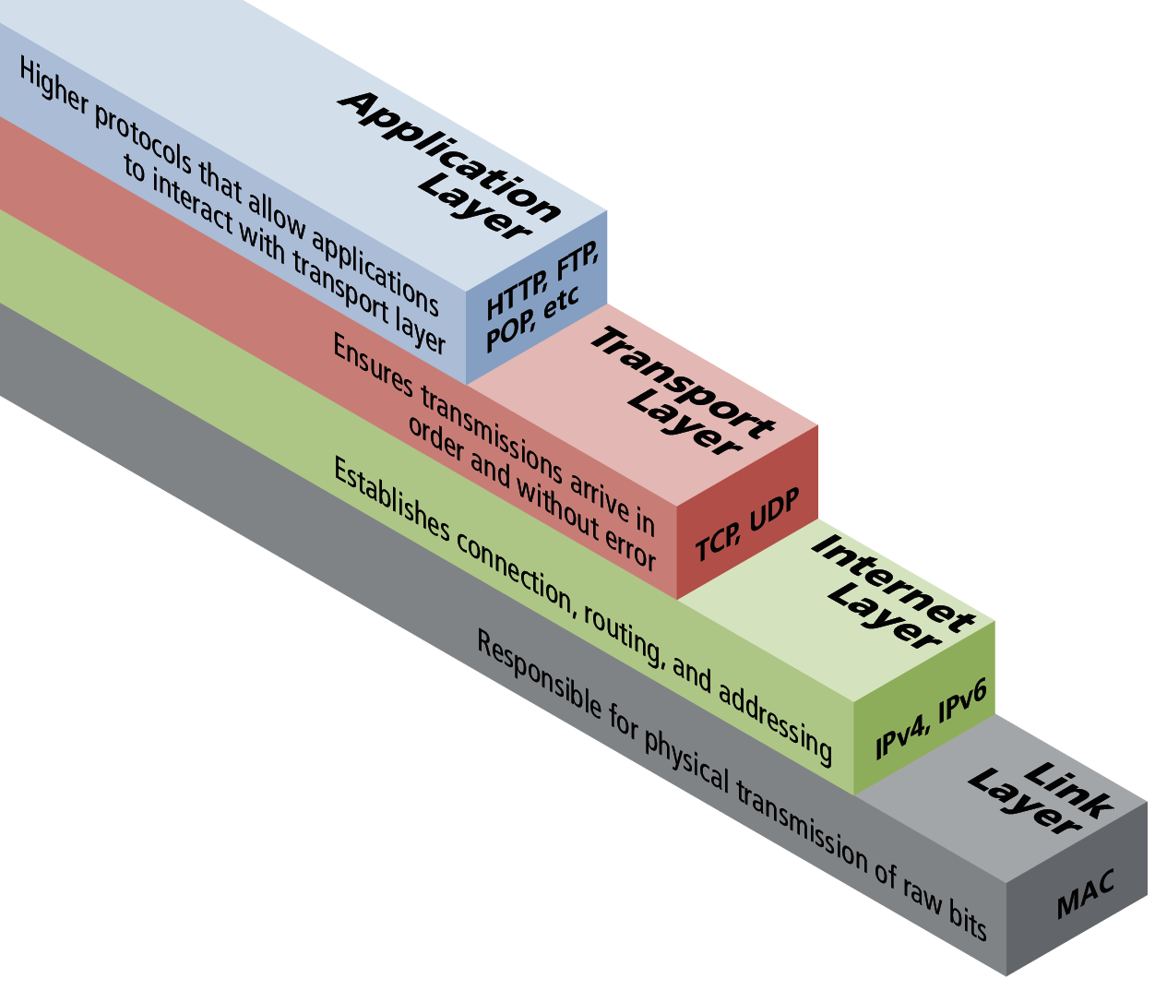
The Internet
The Internet is the worldwide, publicly accessible network of interconnected computer networks that transmit data by packet switching using the standard Internet Protocol (IP). It is a "network of networks" that consists of millions of smaller domestic, academic, business, and government networks, which together carry various information and services, such as electronic mail, online chat, file transfer, and the interlinked Web pages and other documents of the World Wide Web.

Slide 13
Whose ideas are between you and your knowledge and why does it matter?
Notes:
LC4 chaise lounge - Le Corbusier

Slide 15
Notes:
Rene Magritte: “The famous pipe. How people reproached me for it! And yet, could you stuff my pipe? No, it's just a representation, is it not? So if I had written on my picture 'This is a pipe', I'd have been lying!”

Slide 16
Is the Internet a Public Space?
https://youtu.be/FmZbdaqGqlc

Slide 17
"I don't think he [Habermas] really gets the Internet."
Axel Bruns, 2006
(blog post after Habermas's keynote address at the 2006 ICA conference, http://snurb.info/node/621)
"He [Habermas] simply does not understand the Internet”
Howard Rheingold, 2007
(blog post, http://www.smartmobs.com/2007/11/05/ habermas-blows-off-question-about-the-internet-and-the-public-sphere/)

Slide 18
Communicative spaces are not just neutral technological spaces
Discourse for Habermas
Enables people to recognise the intentions of others participating in a discourse;
There is no force or coercion in the discourse;
There is the opportunity to come to a consensus, even if it is not an perfect consensus, on opinions and facts

Slide 19
Habermas embraces the virtual
“If there is to be a realistic application of the idea of the sovereignty of the people to highly complex society, it must be uncoupled from the concrete understanding of its embodiment in physically present, participating, and jointly deciding members of a collectivity.”
- Jurgen Habermas, 1992, 462

Slide 20
And thus we need to consider that…
Facilitated by protocol, the Internet is the most highly controlled mass media hitherto known.
(Galloway, 2004, 243)

Slide 21
Who or what controls….
The key question therefore is never whether control does or does not exist, but rather to ask: What is the quality of this control? Where does it come from? Is it being wielded by governments or deployed at the level of machinic infrastructure?.What is the specific character of information organization? This is the basic question of protocol.
( Galloway interview, 2009)

Slide 22
The more technology we embed into our lives the less freedom we have. This is not Luddism, but understanding how technology controls us
Notes:
(affordance & Shapiro worph).

